Slide 1
CESM 2.2
Creating and Using Variable Resolution Grids
AMWG Winter Meeting
Contributors:
Paul Ulrich, Colin Zarzycki, The CSEG team,
Patrick Callaghan, Adam Herrington,
Julio Bacmeister, Peter Lauritzen
Feb 12, 2021
Notes:
NOTE: Background image can be used as is or changed for a particular presentation in the “Slide Master” button found under the “View” tab.

Slide 2
GitHub Repositories and Demonstration Resources
The programs, scripts, and instructions for creating a new grid are located in the GitHub repository:
https://github.com/ESMCI/Community_Mesh_Generation_Toolkit.git
For users who plan to nudge the model with the new grid and/or wish to run CAM-Chem, the additional processing scripts and programs they will need are located in:
https://github.com/NCAR/IPT.git
Today only the scripts in this repository used to create nudging data will be mentioned.
See the MUSICA documentation, or future tutorial on MUSICA, for details on this repository.
To illustrate the usage of these tools, an example grid will be created in which a uniform ne30 grid is refined to ne120 over South America. The repositories above, the CESM 2.2 release, and the files generated for this demonstration grid are available on the glade file system in:
/glade/scratch/patc/AMWG_DEMO_FEB21/

Slide 3
Overview: The Usage Scenario for VR Grids
The usage scenario for CESM 2.2 and later is that a research group will have a common repository of grid information.
This $(REPO) will contain the VRM grids relevant to their research, which supplements the supported grid resolutions in CESM.
A local repository of grids that can be readily shared by members of a research group using compatible CESM tags.
The data in $(REPO) will need to be updated periodically to keep up with CESM development, but not for every tag.
(Tags earlier than the most recent require a different installation process that is not as flexible as this.)
Research Group Repository
/local/repo/
Repository of Supported Data
/glade/p/…
CESM tag_01
CESM tag_02

Slide 4
Overview: Adding a New Grid
Adding a New Grid To CESM: There are 5 steps to create a new grid for use in CESM model runs.
Download source code and build executables
Creating a new grid
Create a repository of grid data; mapping, domain, initial value datasets, etc…
Install new grid CESM
Establish defaults for stable model runs.
These are the steps that one goes through to get the model running.
For scientifically meaningful runs, nudged runs, or for those using CAM-Chem there is a little more work involved.
(6) Additional Steps:
The surface state must be spun up from the initial default (from step 3 above).
Conservative emissions data must be processed for the new grid.
Nudging data must be process for the new grid

Slide 5
Overview: Files in the Demo Directory
Support information is available in the directory:
/glade/scratch/patc/AMWG_DEMO_FEB21/
This directory contains the source code and processed files for an example VR grid in which the base ne30 grid is refined to ne120 over the South American continent.
The directory contains:
src/cesm2_2_rel/ ← contains the CESM 2.2 release
src/Community_Mesh_Generation_Toolkit/ ← This contains the VRM toolkit
src/IPT/ ← Code for processing Emissions and Nudging data
Demo_Files/ ← step-by-step NOTES for creating a grid
cases/ ← Case directories for testing the new grid
AMWG_REPO/ ← Repository for VR grids that will be created
Mac Users can download a VRM_Editor app:
cd VRM_tools/VRM_Editor/MAC_exe/
scp Xfer_VRM_ForMac.tar my.mac.edu:~/Desktop
The tar file contains VRM_Editor.app that will run on current Mac OS’s

Slide 6
Overview: The Demo_Files Directory
AMWG_DEMO_FEB21-NOTES
Img_SAMGRID01_1.png
Img_SAMGRID01_2.png
Img_SAMGRID01_3.png
Img_SAMGRID01_4.png
Contains the exact commands, step-by-step, used to create the files and run the example grid in the AMWG_DEMO_FEB21 directory. The PNG files are screen shots that are referenced in the notes.
REFMAP_SAMGRID01_Z30-X21.nc
SAMGRID01_ne30x4_EXODUS.nc
The example refinement map and grid file for the South American refinement created using VRM_Editor.
TCreference.nc
An example reference file for tropical cyclone tracks in the Atlantic basin.
REFMAP_SAMGRID01_Z30.7-X22.5-HALO.nc
A variation of the South American refinement map.
The DEMO approach:
There is not enough time to go thru beginning to end.
The <AMWG_DEMO_FEB21> directory contains all of the results and LOG files from the step-by-step commands in the NOTES file.
We will go thru the sequence of commands and review what is being done at each point.
Users are encouraged to follow thru the steps and reproduce the results for this example grid.
The having successfully gone thru the process once, repeat the process with their own grid.
The results in the <AMWG_DEMO_FEB21> directory can then be used as a reference if the user have and problems along the way to creating their new grid.
I will stop briefly after each section to address any immediate questions.
It is assumed that everyone has access to the glade and the NCAR compute environment. Users in other environments will need to adjust scripts to access the relevant datasets on their compute environment.

Slide 7
Overview: Contents of VRM_tools
The VRM_tools directory:
VRM_tools/
SQuadGen/
VRM_Editor/
VRM_ControlVolumes/
gen_ESMFmesh/
gen_mapping/
gen_domain/
gen_CLMsrfdata/
gen_CAMncdata/
gen_atmsrf/
gen_topo/
Install_grid/
VRM_Diagnostics/
Docs/
README
REQUIRED_ENV_SETTINGS
Programs to create a new grid
Create mapping, domain, and input datasets for the new grid
The Docs directory:
VRM_Grids_For_CAMSE.pdf
Contains the full documentation for the creation of a new grid and the associated data files.
CAM-tsteps-inic-for-newgrids_v0.pdf
Contains a guide for establishing default time step and namelist values for a new grid.
Scripts and instructions for installing a new grid in CESM
Diagnostic utils for plotting and testing a new grid
Documentation to guide users through the process

Slide 8
Overview: The Users Repository
Note the naming convention for the Variable Resolution Mesh grids.
When completed, the user has generated a repository of required values for each grid, stored with the following directory structure:
ne0np4.NAME.ne30x4
/my/local/repo/
ne0np4 = all variable resolution grids with 4 GLL points must begin with this.
ne0np4.SAMGRID01.ne30x4/
ne0np4.MyOtherGrid.ne30x8/
atmsrf/
atmsrf/
NAME = unique name for your grid
domains/
domains/
grids/
grids/
ne30 = the base resolution of the unrefined grid.
x4 = The refinement factor for the highest resolution region
e.g. For a ne120 grid: 30x4 = 120.
inic/
inic/
maps/
maps/
topo/
topo/
clm_surfdata_5_0/
clm_surfdata_5_0/

Slide 9
(1) Building Executables
====================================================================
(2) Build the pre-requisite executables
====================================================================
-------------------------------
--> Build VRM_Editor on Casper
-------------------------------
cheyenne% execdav
casper% cd Community_Mesh_Generation_Toolkit/VRM_tools/VRM_Editor/src
casper% module load gnu/9.1.0
casper% qmake-qt5 VRM_Editor.pro
casper% make
---------------
**NOTE**:
--------------- The editor can now be run in this directory:
casper% ./VRM_Editor
* The editor is not as prone to crashing when running on Casper
but users will need to be patient with latency when using
the mouse.
* When running on the VRM_Editor on Casper, be sure to re-load
the gnu/9.1.0 module first:
casper% module list
Currently Loaded Modules:
1) ncarenv/1.3 2) gnu/9.1.0 3) ncarcompilers/0.5.0
4) netcdf/4.7.4 5) openmpi/4.0.5
-------------------------------
--> VRM_Editor For Linux/Mac
-------------------------------
For Linux users, with the Qt and netCDF packages installed,
building the editor is just as simple as for Casper.
For Mac users.... not so much, the pre-built executable in the
MAC_exe directory should work for now.
*** For details on Linux/MAC see the documentation in:
Community_Mesh_Generation_Toolkit/VRM_tools/Docs/VRM_Grids_For_CAMSE.pdf

Slide 10
(1) Building Executables
-------------------------------
--> Build mksurfdata_map
-------------------------------
cheyenne% cd $(AMWG_DEMO_FEB21)/src/cesm2_2_rel/components/clm/tools/mksurfdata_map/src
cheyenne% module load ncl
cheyenne% module list
Currently Loaded Modules:
1) ncarenv/1.3 2) intel/19.0.5 3) ncarcompilers/0.5.0
4) netcdf/4.7.4 5) ncl/6.6.2 6) mpt/2.22
cheyenne% setenv LIB_NETCDF $NCAR_LDFLAGS_NETCDF
cheyenne% setenv INC_NETCDF $NCAR_INC_NETCDF
cheyenne% gmake
-------------------------------
--> Build gen_domains
-------------------------------
cheyenne% cd $(AMWG_DEMO_FEB21)/src/cesm2_2_rel/cime/tools/mapping/gen_domain_files/src
cheyenne% module list
Currently Loaded Modules:
1) ncarenv/1.3 2) intel/19.0.5 3) ncarcompilers/0.5.0
4) netcdf/4.7.4 5) ncl/6.6.2 6) mpt/2.22
cheyenne% ../../../configure --macros-format Makefile --mpilib mpi-serial
cheyenne% (source ./.env_mach_specific.csh ; gmake)
-------------------------------
--> Build interpic
-------------------------------
cheyenne% cd $(AMWG_DEMO_FEB21)/src/cesm2_2_rel/components/cam/tools/interpic_new
cheyenne% module load ncl
cheyenne% module list
Currently Loaded Modules:
1) ncarenv/1.3 2) intel/19.0.5 3) ncarcompilers/0.5.0
4) netcdf/4.7.4 5) mpt/2.22 6) ncl/6.6.2
cheyenne% setenv LIB_NETCDF $NCAR_LDFLAGS_NETCDF
cheyenne% setenv INC_NETCDF $NCAR_INC_NETCDF
cheyenne% gmake
-------------------------------
--> Build Gen_ControlVolumes.exe
-------------------------------
cheyenne% cd $(VRM_tools)/VRM_ControlVolumes/src
cheyenne% module list {check what compiler is set}
Currently Loaded Modules:
1) ncarenv/1.3 2) intel/19.0.5 3) ncarcompilers/0.5.0
4) mpt/2.22 5) netcdf/4.7.4
cheyenne% module load gnu {switch to GNU compiler}
cheyenne% module list
Currently Loaded Modules:
1) ncarenv/1.3 2) gnu/9.1.0 3) ncarcompilers/0.5.0
4) netcdf/4.7.4 5) mpt/2.22
cheyenne% make
cheyenne% module load intel {switch back to default}
----------
**NOTE**: Be sure to use the gnu compiler here. Also, note
---------- the $(VRM_tools) short-hand, it will be used from now on.

Slide 11
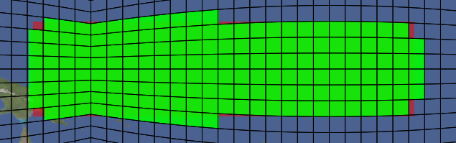
(2) Creating a New Grid
There are currently three programs to create a new grid:
SQuadGen -- Command line program
VRM_Editor -- Interactive GUI for SQuadGen
Create_VRMgrid -- Command line interface for VRM_Editor
These programs create the NE part of the cube-sphere grid and store the results in an EXODUS file.
SQuadGen
To use SQuadGen, the user first creates a rectangular PNG file with an image editor in which brightness values indicate the region of refinement.
Given a base resolution and a refinement level, this image is converted into a cube grid of discrete refinement levels.
The then program uses a specified set of templates to fill in the regions where there is a transition between resolutions
Each element for a NE grid is assigned an integer value indicating the level of refinement to perform.

Slide 12
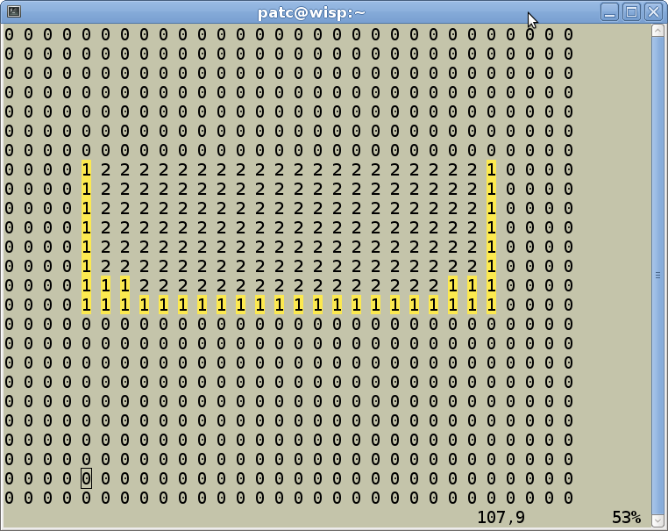
(2) Creating a New Grid
computer>./SQuadGen
Parameters:
--grid_type <string> ["CS"] (Options: ICO | CS)
--refine_type <string> ["LOWCONN"] (Options: LOWCONN | CUBIT | LOWCONNOLD)
--refine_level <integer> [2]
--resolution <integer> [10]
--refine_file <string> [""]
--output <string> [""]
--loadcsrefinementmap <bool> [false]
--smooth_type <string> ["NONE"] (Options: NONE | SPRING | PRESSURE)
--smooth_dist <integer> [1] (Smooth distance, -1 = smooth entire mesh)
--smooth_iter <integer> [10]
--lon_base <double> [-180.000000]
--lat_base <double> [0.000000]
--x_rotate <double> [0.000000]
--y_rotate <double> [0.000000]
--tessellate <integer> [0]
--subcellres <integer> [0]
--invert <bool> [false]
--block_refine <bool> [false]
SQuadGen
SQuadGen has command line options to specify the refinement resolutions, template type, smoothing options, and rotation angles which control the resulting grid.
Running the program with no options will produce a listing of the available options.
The program also writes out the discrete refinement values in a text file that can be edited manually.
Users can iteratively edit and feed these values back into SQuadGen to tailor the grid appearance as desired.

Slide 13
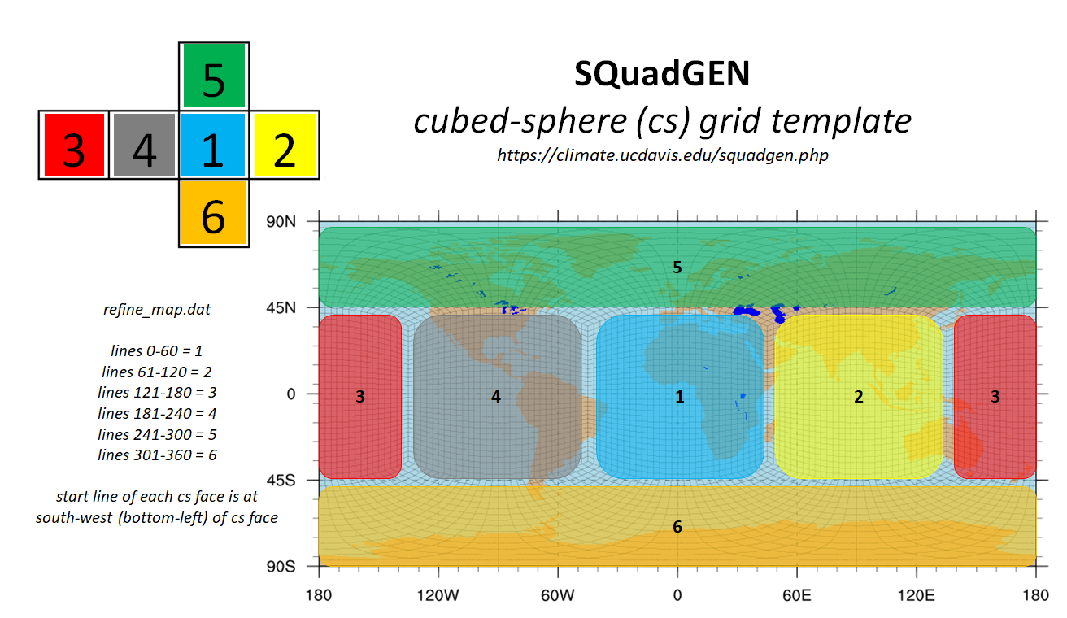
(2) Creating a New Grid
The layout of the values in the SQuadGen refinement file is illustrated in the following figure (Courtesy of Alan Rhodes)

Slide 14
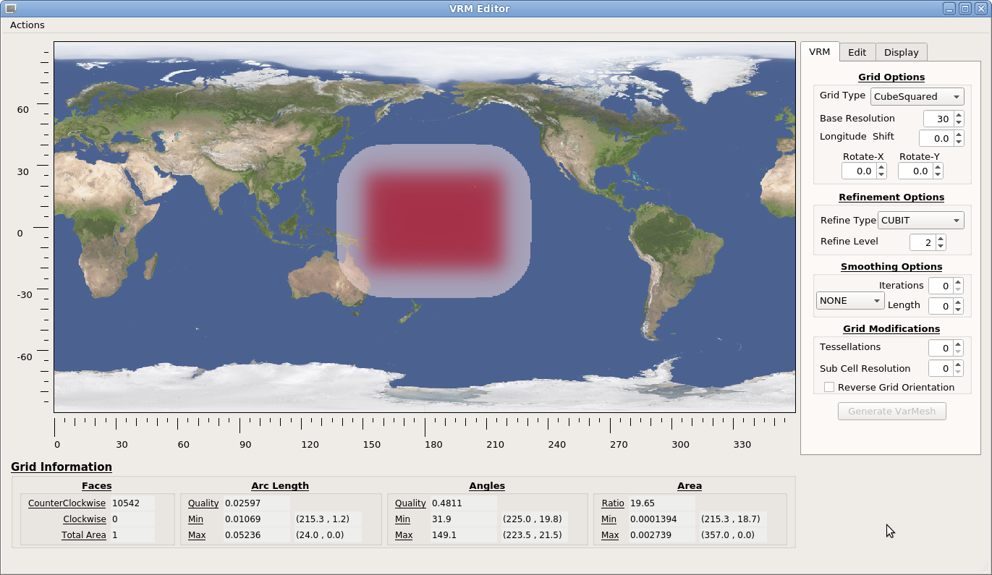
(2) Creating a New Grid
VRM_Editor
VRM_Editor is a GUI interface for SQuadGen but it uses a different approach to define refinements.
Rather than editing an image, the approach is to edit a map of continuous refinement values [0.,1.] on a (Lat,Lon) grid directly. Where values equal to 1, shown in red, define the desired region of refinement.
These values are stored/read from a netCDF file with a defined (Lat,Lon) grid rather than relying on an implied (Lat,Lon) grid for a rectangular image.
The Actions menu at the upper left has options for reading/writing refinement maps and newly created grids.
When a grid is created, the table at the bottom of the interface provides quality information about the grid. Including the min/max area, angle, arc length, and the locations of those extreme values.
On the right is a set of tools for editing and creating the grid.

Slide 15
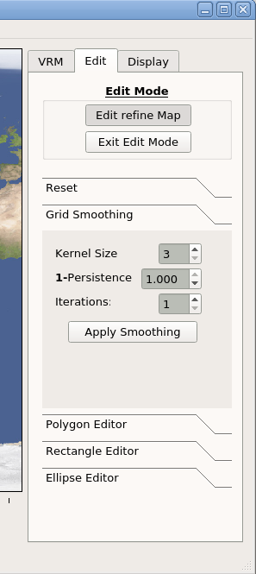
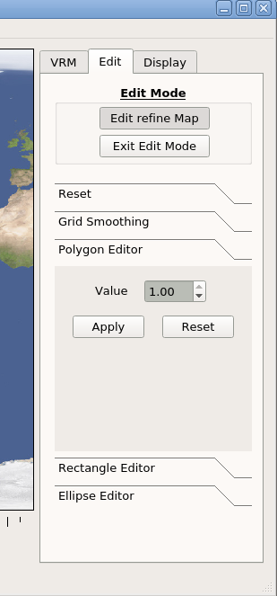
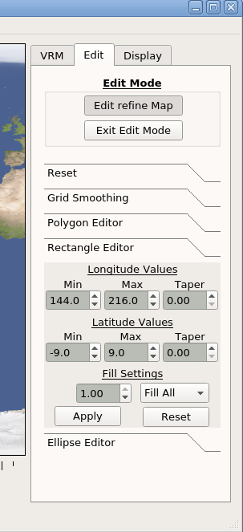
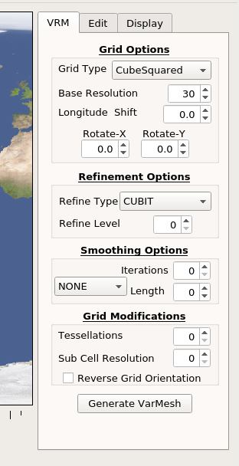
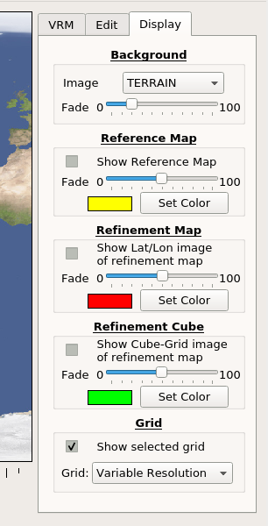
(2) Creating a New Grid
VRM_Editor
In addition to all of the SQuadGen options, the editor has tools used to create and modify the refinement map.
There is also set of options control the appearance of the displayed values in the editor.

Slide 16
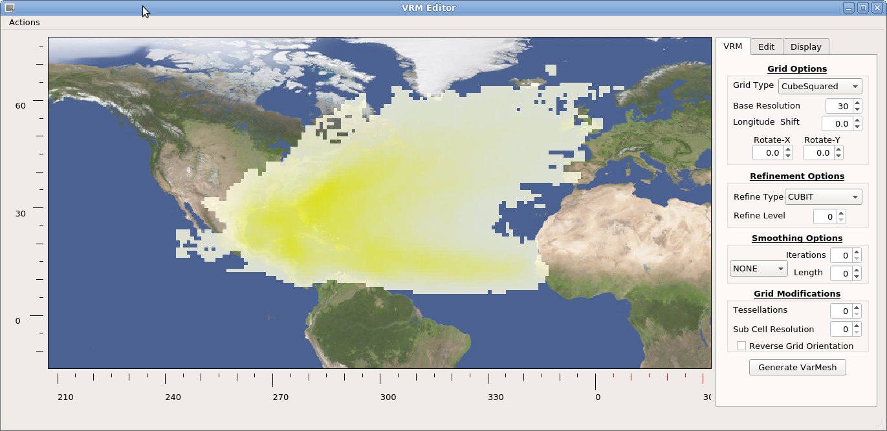
(2) Creating a New Grid
VRM_Editor
Optionally, a refence map based on observed phenomena can be read in and used as a guide for creating refined regions.
Values on a (Lat,Lon) grid are displayed with a yellow color gradient between min and max.
The example here is a PDF of tropical storm tracks in the Atlantic basin.
(available in the Demo_Files directory)

Slide 17
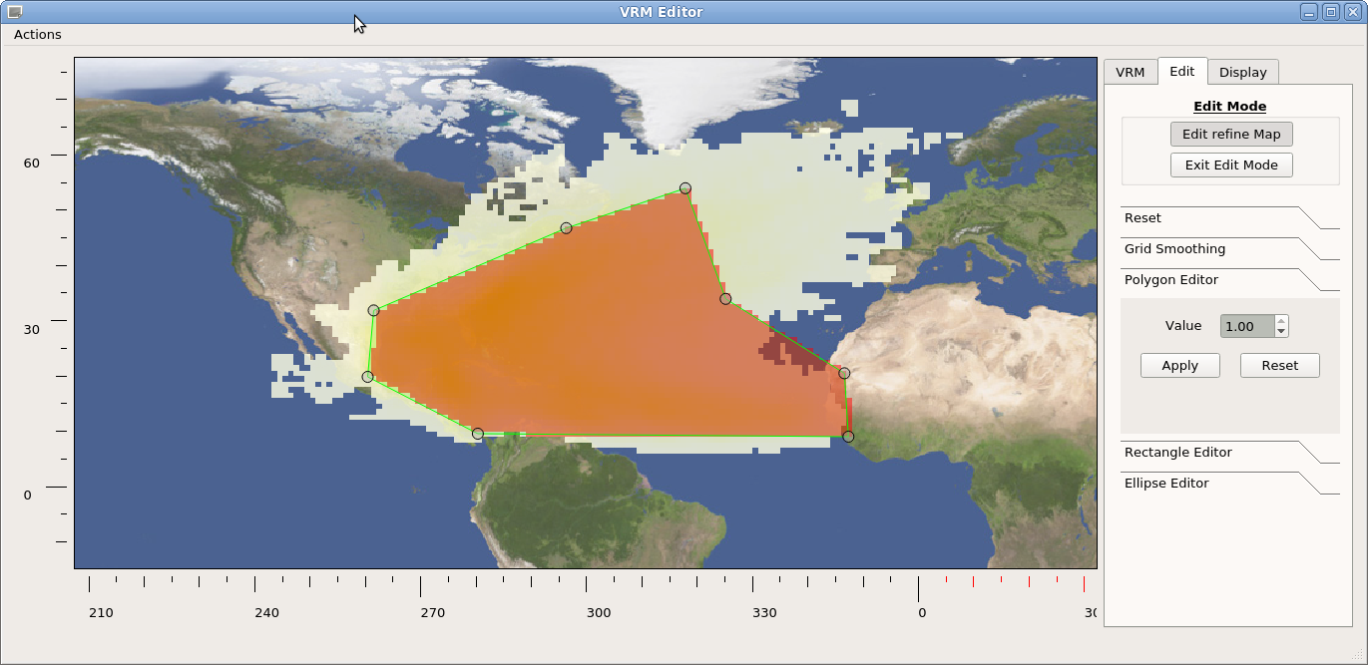
(2) Creating a New Grid
VRM_Editor
For a refinement from ne30 to ne120 for example there are 2 refinement levels.
The polygon editor can be used to first construct a ne120 region which encompasses the desired variability by setting a refinement value equal to 1.

Slide 18
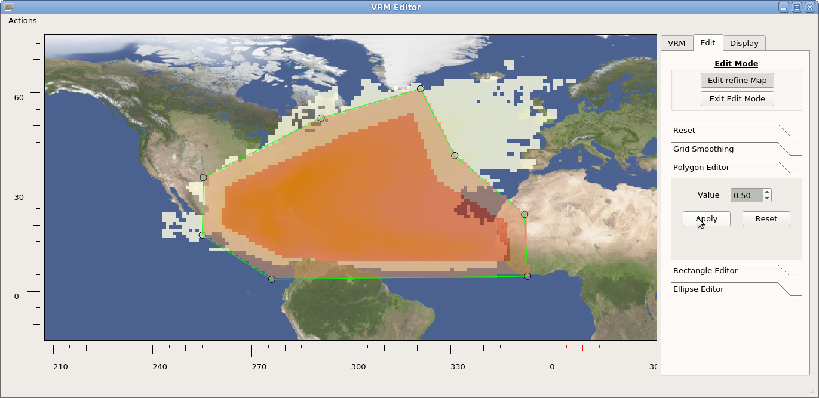
(2) Creating a New Grid
VRM_Editor
An expanded perimeter is then added with a value of 0.5 to define a transition region which will correspond to a ne60 grid resolution.

Slide 19
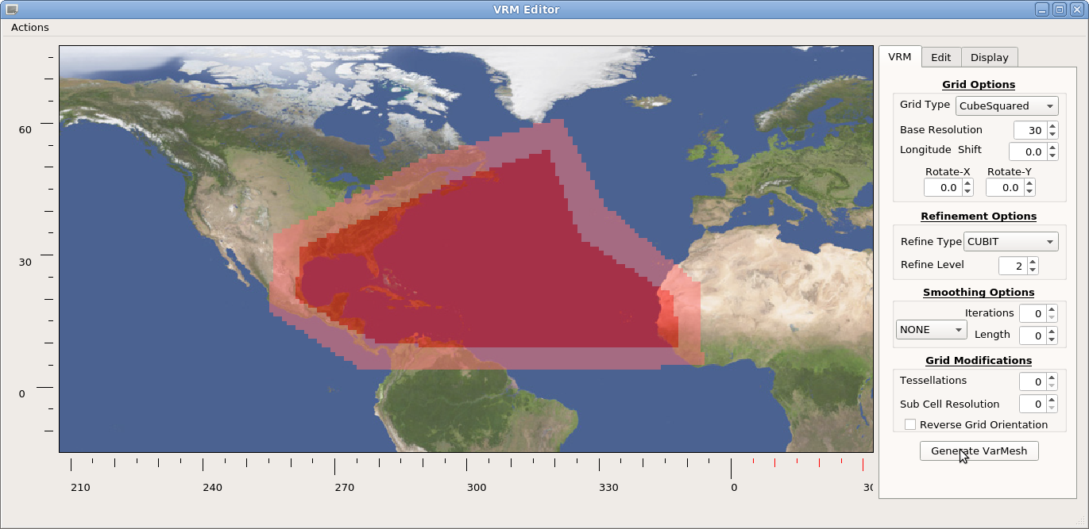
(2) Creating a New Grid
VRM_Editor
The resulting refinement map contains incremental changes between values with some sharp vertices.

Slide 20
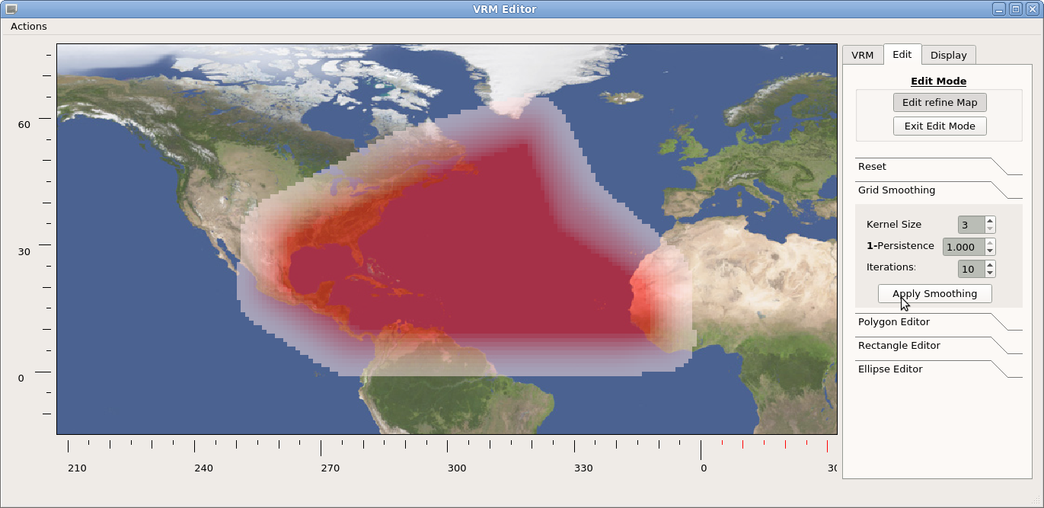
(2) Creating a New Grid
VRM_Editor
Using the smoothing tool, these rough edges can be rounded to get a more satisfactory refinement map.

Slide 21
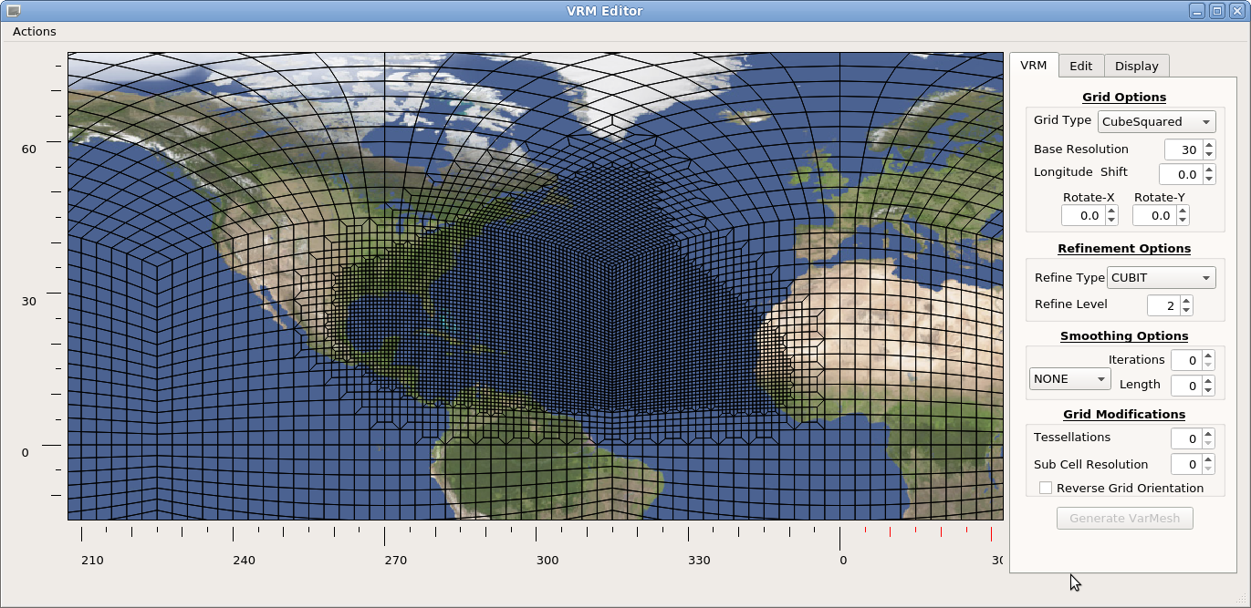
(2) Creating a New Grid
VRM_Editor
Once the refinement map changes are accepted, the SQuadGen parameters are set and the resulting refined grid generated.

Slide 22
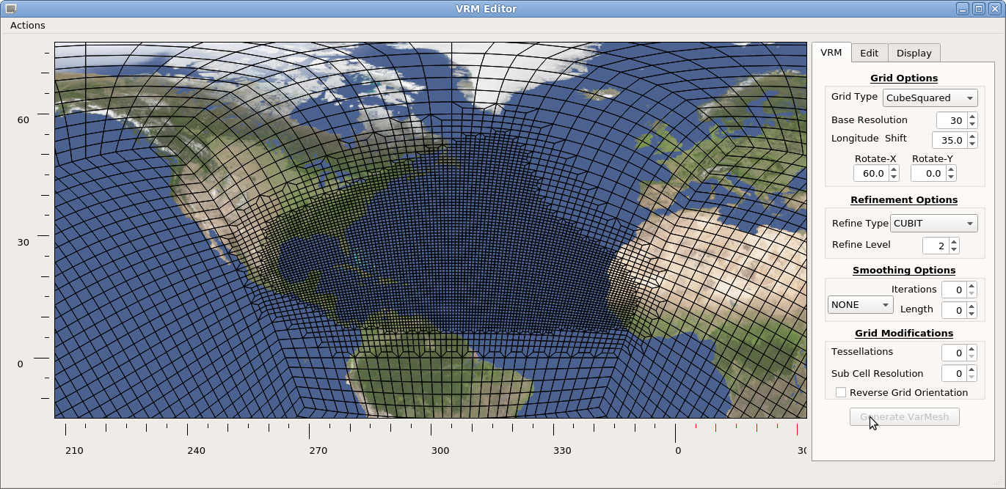
(2) Creating a New Grid
VRM_Editor
As a general rule, the refined regions should be centered, as much a possible, on one of the cube faces.
After adjusting values to rotate the base grid and selecting refinement and smoothing options, the final grid is ready to be saved.

Slide 23
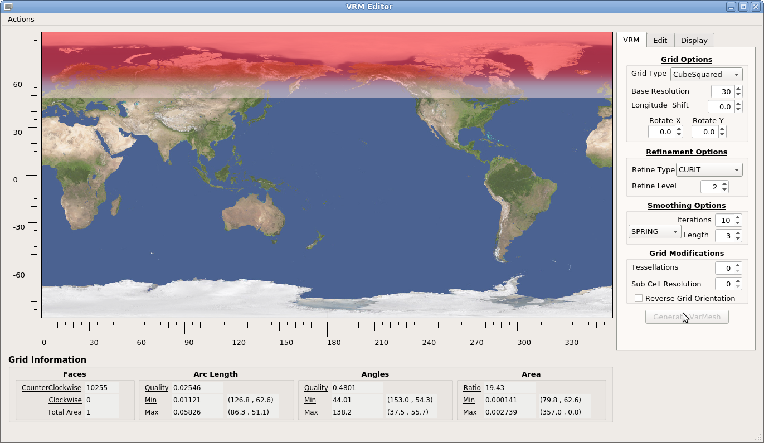
(2) Creating a New Grid
VRM_Editor
To create an ne30 grid which is refined to ne120 for Latitudes higher than 60N:
The rectangle editor is used to create a refinement map with value 1 over the pole, which tapers down to 0 at 60N.

Slide 24
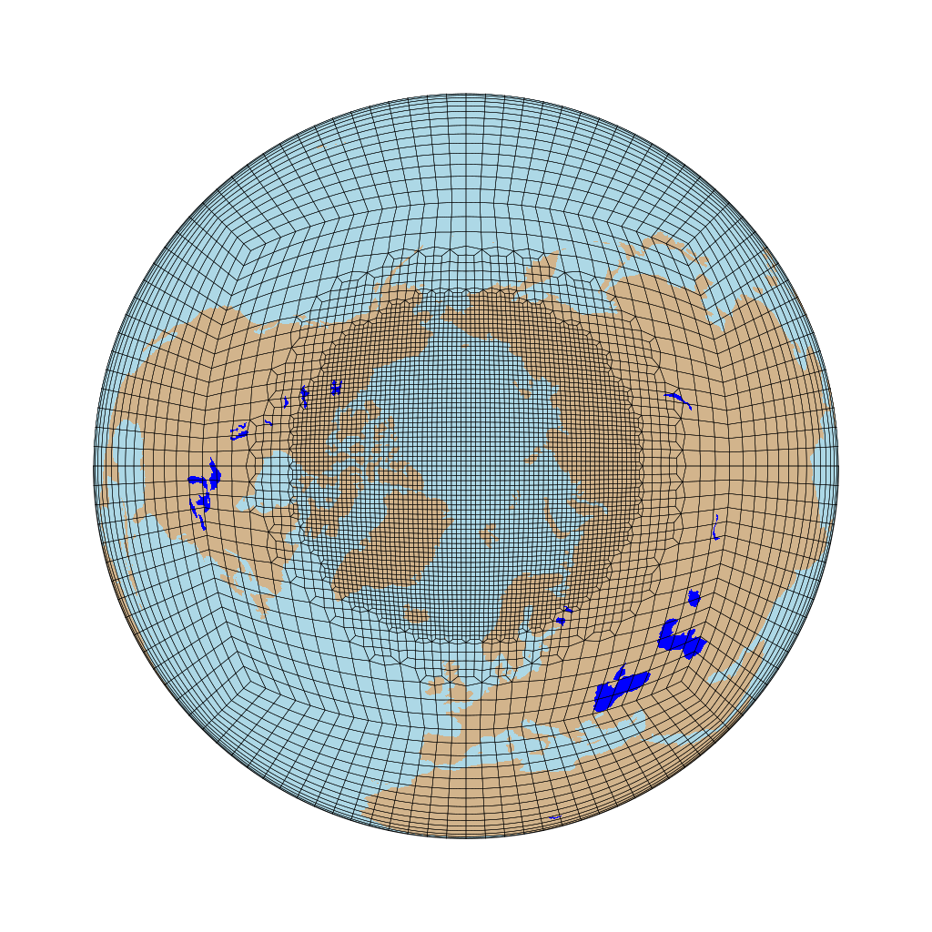
(2) Creating a New Grid
VRM_Editor
Setting the SQuadGen parameters for a ne30 base resolution, 2 refinements, and some grid smoothing creates a grid with a circumpolar refinement.

Slide 25
(2) Creating a New Grid
VRM_Editor
Now Consider a ne30 grid with a ne120 circumpolar refinement with a local refinement to ne240 over Greenland.
R
1.00
ne240
The range of refinement values is discretized and assigned to refinement levels as shown.
For the circumpolar part of the refinement, the rectangle edit tool is used in the same manner as before, but the maximum value in the rectangle is set to 0.82 (< 0.83).
For the ne240 region, the polygon editor is then used to add a region where the values are set equal to 1.
R = 0.83
0.66
ne120
R = 0.50
0.33
ne60
R = 0.16
ne30
0.00

Slide 26
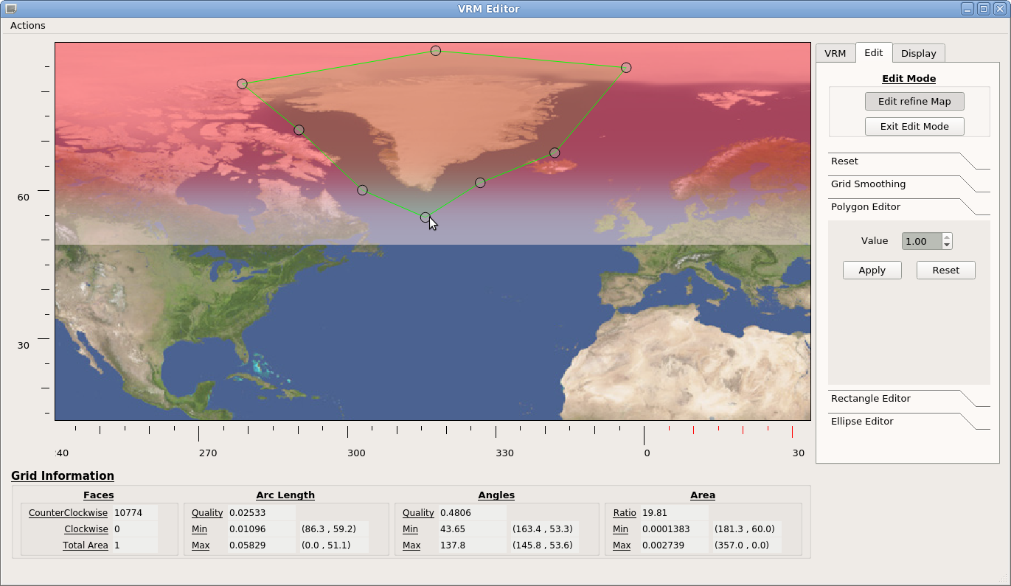
(2) Creating a New Grid
VRM_Editor
The polygon vertices are moved to create a region which encompasses Greenland.

Slide 27
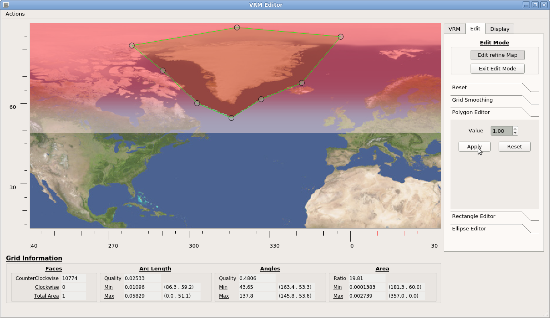
(2) Creating a New Grid
VRM_Editor
After the polygonal region is added, there is a relatively sharp transition between R=1 and R=0.82 values.

Slide 28
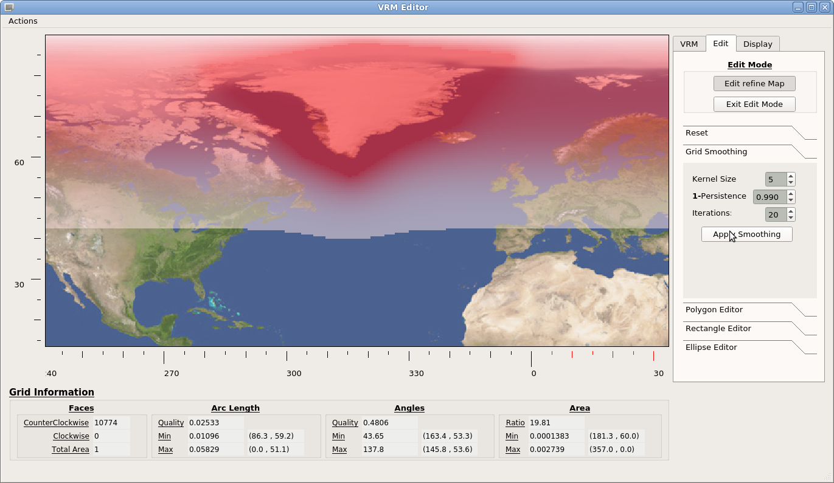
(2) Creating a New Grid
VRM_Editor
Apply smoothing to round the sharp edges.

Slide 29
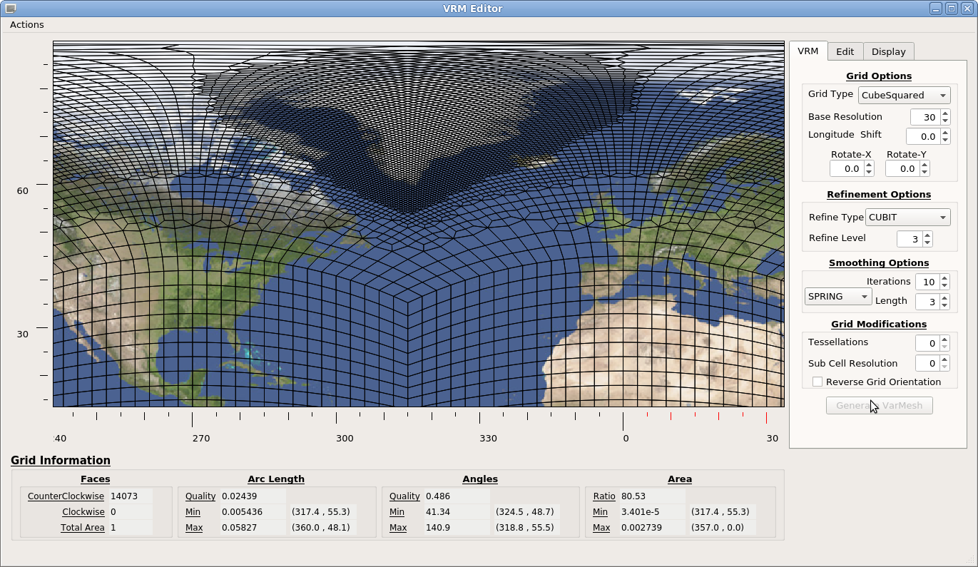
(2) Creating a New Grid
VRM_Editor
Then save the refinement map, set the SQuadGen parameters, and generate the grid

Slide 30
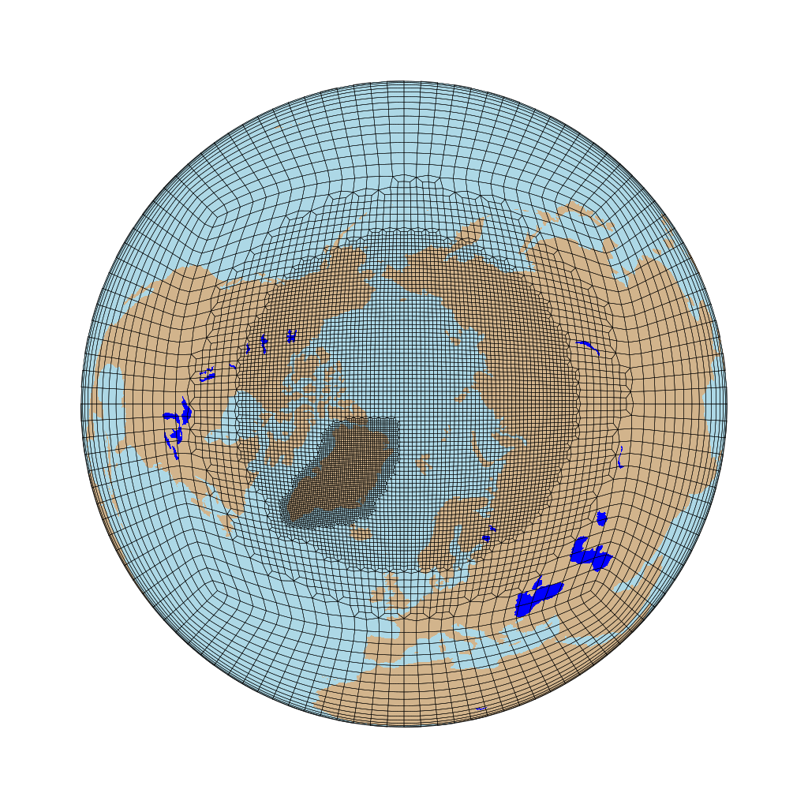
(2) Creating a New Grid
VRM_Editor
The final result is then a circumpolar refinement to ne120 over the North pole with a local refinement to ne240 over Greenland.

Slide 31
(2) Creating a New Grid
Create_VRMgrid
computer>./Create_VRMgrid
Input Parameters:
--refine_type <string> ["CUBIT"] (Options: CUBIT | LOWCONN | LOWCONNold)
--grid_type <string> ["CubeSquared"] (Options: Icosahedral | CubeSquared)
--smooth_type <string> ["NONE"] (Options: NONE | SPRING | PRESSURE)
--resolution <integer> [30]
--refine_level <integer> [0]
--tessellate <integer> [0]
--subcells <integer> [0]
--smooth_dist <integer> [0]
--smooth_iter <integer> [0]
--reverse_orient <bool> [false]
--x_rotate <double> [0.000000]
--y_rotate <double> [0.000000]
--lon_shift <double> [0.000000]
--refine_file <string> ["NULL"]
--output <string> ["NULL"]
Create_VRMgrid is a command line interface that works very much like SQuadGen.
Rather than providing a PNG image, the user provides a netCDF file containing the refinement map values.
This file can be an output from the VRM_Editor, or a file created by some other means.
Once the EXODUS file is created, transfer it to Cheyenne to create a repository:
Create $(AMWG_REPO)/ne0np4.SAMGRID01.ne30x4/
Create $(AMWG_REPO)/ne0np4.SAMGRID01.ne30x4/grids/ ← NOTE the naming conventions.
Copy SAMGRID01_ne30x4_EXODUS.nc to the grids/ directory.

Slide 32
(2) Creating a New Grid
Demonstration: Creating a South American refinement grid
At this point, users should refer to the file AMWG_DEMO_FEB21-Notes
In the directory: /glade/scratch/patc/AMWG_DEMO_FEB21/Demo_Files
This file contains the step-by-step command I used to create and use an ne30 grid with a regional ne120 refinement over the South American continent.
Included are informative notes that were made along the way.

Slide 33
(2) Creating a New Grid
====================================================================
(3) Create a new VR grid
====================================================================
cheyenne% execdav
casper% cd $(AMWG_DEMO_FEB21)/src/Community_Mesh_Generation_Toolkit/VRM_tools/VRM_Editor/src
casper% module load gnu/9.1.0
casper% ./VRM_Editor
---------------
**NOTE**:
---------------
The example grid will be an ne30 grid with a ne120 refinement centered over South America in
which the refinement region is a rectangle that is quasi-aligned with the rectangular grid of the
cube face. (equi-distant w.r.t. great circle lengths)
The nomenclature for the resulting EXODUS file is:
SAMGRID01_ne30x4_EXODUS.nc
-----------------
VRM_Editor:
-----------------
As a general rule, we always want to try and center the refined region
on a cube face. For this grid, that means S.America.
-Create a default grid - click ->Generate VarMesh
-Zoom in on S. America
-Set the grid rotation values to center on S.America:
Lon = 30. , X = 21. ->Generate VarMesh
- The grid line now provide a guide for creating the
rectangular region.
Use the Polygon Editor create the refinement region.
SAVE: Actions -> Save Refinement Map
---> REFMAP_SAMGRID01_Z30-X21
- Create initial grid: CUBIT/NOSMOOTH/ Refine=2
---------------
**NOTE**: {SEE: Img_SAMGRID01_1.png}
--------------- The geometric structure of the templates used for transition elements.
Note also, that the transition region(ne60) is small and not uniform around the perimeter.
- Two settings that help with this are the Refine Type and Smoothing options. The LOWCONN uses
templates that span 2x2 base elements to transition between resolutions, and the SPRING
smoothing rounds out the element shapes to ~reduce~ sharp angles.
LOWCONN SPRING: 3@3
SAVE: Actions -> Write Exodus File
---> SAMGRID01_ne30x4_EXODUS.nc
---------------
**NOTE**: {SEE: Img_SAMGRID01_2.png}
--------------- The smooth and uniform nature of the transition around the perimeter.
A good rule of thumb: The nicer the grid looks, the more uniform and symmetric it is, the
better it tends to behave numerically.
For some uses, the width of the transition region does not matter (e.g. nudged boundary
conditions). In other cases it is desirable to have a more gradual transition between the
high and low res regions.
- Use the polygon editor to add a 0.5 halo around the region.
---------------
**NOTE**: {SEE: Img_SAMGRID01_3.png}
--------------- The resulting grid extends the transition but uniformity and symmetry are out the
window. The command line program offers a method to fix this sort of behavior.
As an alternative to this, slight modifications to the rotation angles will change the
roundoffs in the refinement software which leads to better/worse behavior.
Iteratively adjusting these values invariably leads to a well behaver grid.
In this case: X=22.5 Lon=30.7
{SEE: Img_SAMGRID01_4.png}
SAVE: Actions -> Save Refinement Map
---> REFMAP_SAMGRID01_Z30.7-X22.5-HALO
SAVE: Actions -> Write Exodus File
---> SAMHALO01_ne30x4_EXODUS.nc

Slide 34
(2) Creating a New Grid
Summary of Best practices
Refinement regions whose boundaries are aligned with spectral element grid lines tend to behave better numerically.
Regions that “look” good – have a uniform/symmetric appearance – tend to behave better numerically.
LOWCONN should be used instead of CUBIT.
Always use some amount of SPRING smoothing.
Convex regions tend to behave better numerically compared to regions that have concave vertices.
If you are having trouble with a grid, e.g. it needs large sub-cycling settings, then there is likely a problem with your grid. In the long run, you are better off iterating with variations/adjustments to your grid to get better performance.

Slide 35
(3) Creating a Repository For The New Grid
Create a REPO Directory
If a repository for you grid and data files does not yet exist, create one. For now, we will use:
/glade/scratch/patc/AMWG_DEMO_FEB21/AMWG_REPO/
Create a directory in the REPO for the new grid:
ne0np4.SAMGRID01.ne30x4
Add your EXODUS file containing the NE part of the grid as a starting point. The contents of the EXODUS file are augmented with all of the VRM_Editor settings and refinement map used to create the grid.
For future use, it is a good practice to save REFMAP files in this directory as well.
====================================================================
(4) Create a REPO directory for the new grid;
Copy the EXODUS and REFMAP files to the REPO.
NOTATION: $(AMWG_DEMO_FEB21) == /glade/scratch/patc/AMWG_DEMO_FEB21
NOTATION: $(AMWG_REPO) == /glade/scratch/patc/AMWG_DEMO_FEB21/AMWG_REPO
====================================================================
cheyenne% mkdir $(AMWG_DEMO_FEB21)/AMWG_REPO
cheyenne% mkdir $(AMWG_DEMO_FEB21)/AMWG_REPO/ne0np4.SAMGRID01.ne30x4/
cheyenne% mkdir $(AMWG_DEMO_FEB21)/AMWG_REPO/ne0np4.SAMGRID01.ne30x4/grids
cheyenne% cp SAMGRID01_ne30x4_EXODUS.nc $(AMWG_DEMO_FEB21)/AMWG_REPO/ne0np4.SAMGRID01.ne30x4/grids
cheyenne% cp REFMAP_SAMGRID01_Z30-X21.nc $(AMWG_DEMO_FEB21)/AMWG_REPO/ne0np4.SAMGRID01.ne30x4/grids
cheyenne% ls -F $(AMWG_DEMO_FEB21)/AMWG_REPO/*/*
/glade/scratch/patc/AMWG_DEMO_FEB21/AMWG_REPO/ne0np4.SAMGRID01.ne30x4/grids:
REFMAP_SAMGRID01_Z30-X21.nc SAMGRID01_ne30x4_EXODUS.nc

Slide 36
(3) Creating a Repository For The New Grid
Gen_ControlVolumes
The process of generating the grid points is completed by running this program.
It adds the (NPxNP) GLL grid points for each element to support the Legendre basis functions and stores the final grid description in SCRIP/LATLON files.
When completed, the user has 3 separate files describing the grid.
====================================================================
(5) Create VR grids from EXODUS file
====================================================================
-------------------------------
Create SCRIP/LATLON grid files:
-------------------------------
cheyenne% cd $(AMWG_DEMO_FEB21)/src/Community_Mesh_Generation_Toolkit/VRM_tools/VRM_ControlVolumes/src
cheyenne% cp input.nl input.nl-ORIG
cheyenne% vi input.nl
- Set the namelist values to point to the new SAMGRID01 grid file and then run the
Gen_ControlVolumes program.
&input_nl
GridPath = '/glade/scratch/patc/AMWG_DEMO_FEB21/AMWG_REPO/
ne0np4.SAMGRID01.ne30x4/grids/'
GridName = 'SAMGRID01_ne30x4'
/
cheyenne% module load gnu
cheyenne% ./Gen_ControlVolumes.exe input.nl > LOG_SAMGRID01.ne30x4 [ ~2 seconds to run]
cheyenne% ls /glade/scratch/patc/AMWG_DEMO_FEB21/AMWG_REPO/ne0np4.SAMGRID01.ne30x4/grids
REFMAP_SAMGRID01_Z30-X21.nc SAMGRID01_ne30x4_EXODUS.nc
SAMGRID01_ne30x4_np4_LATLON.nc SAMGRID01_ne30x4_np4_SCRIP.nc

Slide 37
(3) Creating a Repository For The New Grid
Set ENV Variables For Processing Scripts
The majority of steps from here on consist of a two step process:
(1) Run a MAKE script which uses a set
of environment variable to construct
the needed processing script.
(2) Run the scripts generated by MAKE.
Use ncdump on the LATLON file to get the number of grid points.
Then set the needed environment variables. See the REQUIRED_ENV_SETTINGS file in the VRM_tools directory for more information.
The VRM_DATE value here over-rides the creation dates typically generated by the processing programs.
- Get the number of columns in the new grid:
cheyenne% ncdump $(AMWG_DEMO_FEB21)/AMWG_REPO/ne0np4.SAMGRID01.ne30x4/grids/SAMGRID01_ne30x4_np4_LATLON.nc | grep ncol
ncol = 116534 ; <--- WE NEED THIS NUMBER!
double lat(ncol) ;
double lon(ncol) ;
double area(ncol) ;
cheyenne% setenv VRM_CESM_TAG "/glade/scratch/patc/AMWG_DEMO_FEB21/src/cesm2_2_rel/"
cheyenne% setenv VRM_REPO_PATH "/glade/scratch/patc/AMWG_DEMO_FEB21/AMWG_REPO/"
cheyenne% setenv VRM_GRID_TAG "SAMGRID01_ne30x4"
cheyenne% setenv VRM_GRID_NAME "ne0np4.SAMGRID01.ne30x4"
cheyenne% setenv VRM_GRID_NCOL "116534"
cheyenne% setenv VRM_DATE "210207”
--------------- The majority of the steps from here on involve a process in which a configuration script is run
**NOTE**: first. It uses these environment variables to generate the scripts that process the needed data.
--------------- See the file REQUIRED_ENV_SETTINGS in the $(VRM_tools) directory for more info.
Set VRM_DATE to the current date and keep it unchanged throughout the following steps. This
over-rides the date stamp that is generated by default. --- which caused scripting problems if the
user did not complete all VR data processing on the same calendar date.

Slide 38
(3) Creating a Repository For The New Grid
Create a MESH File:
The CESM model is in the process of transitioning to NUOPC/ESMF. When complete the mapping/domain files will be obsolete and replaced with functionality that only requires a MESH file.
For compatibility with this future change, a MESH file is created and stored with the other grid files.
After this step, the creation of the grid is complete and there are 4 separate files describing the new grid.
----------------------
Create MESH grid file:
----------------------
cheyenne% cd $(AMWG_DEMO_FEB21)/src/Community_Mesh_Generation_Toolkit/VRM_tools/gen_ESMFmesh/
cheyenne% ./MAKE_ESMFmesh_script.csh
cheyenne% execdav
casper% cd ne0np4.SAMGRID01.ne30x4
casper% chmod 744 gen_ESMFmesh_SAMGRID01_ne30x4.sh
casper% ./gen_ESMFmesh_SAMGRID01_ne30x4.sh >& LOG_SAMGRID01_ne30x4 [ ~2 seconds]
casper% ls /glade/scratch/patc/AMWG_DEMO_FEB21/AMWG_REPO/ne0np4.SAMGRID01.ne30x4/grids
REFMAP_SAMGRID01_Z30-X21.nc SAMGRID01_ne30x4_np4_LATLON.nc
SAMGRID01_ne30x4_np4_SCRIP.nc SAMGRID01_ne30x4_EXODUS.nc
SAMGRID01_ne30x4_np4_MESH.nc
EXODUS = File convention for Finite Element Modeling
(NE part of the grid only)
SCRIP = Contains weights for interpolating between
grids in spherical coordinates
LATLON = Contains unique lat/lon grid points typically
found in history files.
PLUS connectivity information.
MESH = Contains enhanced information used for
ESMF interpolation.

Slide 39
(3) Creating a Repository For The New Grid
Generate Datasets
====================================================================
(6) Create VR Datasets
NOTATION: $(VRM_tools) == glade/scratch/patc/AMWG_DEMO_FEB21/src/Community_Mesh_Generation_Toolkit/VRM_tools
====================================================================
----------------------
gen_mapping
----------------------
cheyenne% cd $(VRM_tools)/gen_mapping
cheyenne% ./MAKE_genMapping_scripts.csh
cheyenne% cd ne0np4.SAMGRID01.ne30x4/
cheyenne% qcmd -- 'sh gen_mapping_SAMGRID01_ne30x4_01.sh >& LOG_SAMGRID01_ne30x4_01' [ ~25 seconds ]
cheyenne% qcmd -- 'sh gen_mapping_SAMGRID01_ne30x4_02.sh >& LOG_SAMGRID01_ne30x4_02' [ ~40 seconds ]
cheyenne% qcmd -- 'sh gen_mapping_SAMGRID01_ne30x4_03.sh >& LOG_SAMGRID01_ne30x4_03' [ ~2:20 to run]
cheyenne% ls /glade/scratch/patc/AMWG_DEMO_FEB21/AMWG_REPO/ne0np4.SAMGRID01.ne30x4/
grids/ maps/
----------------------
gen_domain
----------------------
cheyenne% cd $(VRM_tools)/gen_domain
cheyenne% ./MAKE_genDomains_scripts.csh
cheyenne% cd ne0np4.SAMGRID01.ne30x4/
cheyenne% qcmd -- 'sh genDomains_SAMGRID01_ne30x4_gx1v7.sh >& LOG_SAMGRID01_ne30x4_gx1v7’ [~0:20 to run]
cheyenne% qcmd -- 'sh genDomains_SAMGRID01_ne30x4_tx0.1v2.sh >& LOG_SAMGRID01_ne30x4_tx0.1v2' [~7:30 to run]
cheyenne% ls /glade/scratch/patc/AMWG_DEMO_FEB21/AMWG_REPO/ne0np4.SAMGRID01.ne30x4/
domains/ grids/ maps/
----------------------
gen_CLMsrfdata
----------------------
cheyenne% cd $(VRM_tools)/gen_CLMsrfdata
cheyenne% ./MAKE_genCLMsurfdata_script.csh
cheyenne% cd ne0np4.SAMGRID01.ne30x4/
cheyenne% vi genCLMsurfdata_SAMGRID01_ne30x4.sh <---- MUST SET A PROJECT NUMBER!
cheyenne% qsub < genCLMsurfdata_SAMGRID01_ne30x4.sh [ ~1:00:00 one hour for this grid]
cheyenne% ls /glade/scratch/patc/AMWG_DEMO_FEB21/AMWG_REPO/ne0np4.SAMGRID01.ne30x4/
clm_surfdata_5_0/ domains/ grids/ maps/
The user begins by setting some grid-dependent environment variables
After that, the process is the same for each of the gen_XXXX directories:
cd to the gen_XXXX directory
Run a script which generates a grid directory containing the processing scripts that will generate the needed datasets.
Verify the settings in each script and then run it.
Check the output LOG file to verify that the program did not have any errors.
The majority of problems users have during this process is a result of not having the correct modules loaded. To try and avoid confusion, modules are explicitly listed before each command in the NOTES file. (omitted here)

Slide 40
(3) Creating a Repository For The New Grid
Generate Datasets
----------------------
gen_CAMncdata
----------------------
cheyenne% cd $(VRM_tools)/gen_CAMncdata
cheyenne% ./MAKE_interpic_script.csh
cheyenne% cd ne0np4.SAMGRID01.ne30x4/
cheyenne% qcmd -- 'sh interpic_script_SAMGRID01_ne30x4.sh >& LOG_SAMGRID01_ne30x4' [~0:30 to run]
cheyenne% ls /glade/scratch/patc/AMWG_DEMO_FEB21/AMWG_REPO/ne0np4.SAMGRID01.ne30x4/
clm_surfdata_5_0/ domains/ grids/ inic/ maps/
----------------------
gen_atmsrf
----------------------
cheyenne% cd $(VRM_tools)/gen_atmsrf
cheyenne% ./MAKE_genAtmsrf_script.csh
cheyenne% cd ne0np4.SAMGRID01.ne30x4/
cheyenne% qcmd -- 'ncl gen_atmsrf_SAMGRID01_ne30x4.ncl >& LOG_SAMGRID01_ne30x4' [~1:00 to run]
cheyenne% ls /glade/scratch/patc/AMWG_DEMO_FEB21/AMWG_REPO/ne0np4.SAMGRID01.ne30x4/
atmsrf/ clm_surfdata_5_0/ domains/ grids/ inic/ maps/
----------------------
gen_topo
----------------------
cheyenne% cd $(VRM_tools)/gen_topo/Regrid_topo
cheyenne% ./MAKE_RegridTopo_script.csh
cheyenne% cd ne0np4.SAMGRID01.ne30x4/
cheyenne% qcmd -- 'ncl Regrid_topo_SAMGRID01_ne30x4.ncl >& LOG_SAMGRID01_ne30x4' [~0:30 to run]
cheyenne% ls /glade/scratch/patc/AMWG_DEMO_FEB21/AMWG_REPO/ne0np4.SAMGRID01.ne30x4/
atmsrf/ clm_surfdata_5_0/ domains/ grids/ inic/ maps/ topo/
The CLM and true topography files take the longest to generate.
The Regrid_topo script shown here only interpolates the current ne120 topography file and should only be used for testing when the true topography file is not available.

Slide 41
(3) Creating a Repository For The New Grid
====================================================================
(7) Generate TRUE topography
====================================================================
------------------------
Check out topo software
------------------------
cheyenne% cd $(VRM_tools)/gen_topo
cheyenne% mkdir topo
cheyenne% git clone https://github.com/NCAR/Topo.git topo [ 15-20 Min for this to run]
cheyenne% cd topo
cheyenne% git checkout TopoCESM2
------------------------------------------------
Configure for the new grid and run the program
------------------------------------------------
cheyenne% execdav
casper% cp experiment_settings.make experiment_settings.make-ORIG
casper% vi experiment_settings.make
- Comment out the current 'export case=' line
- Add: export case=SAMGRID01.30_x4_C0060_ridge
- Add setting for this case:
ifeq ($(case),SAMGRID01.30_x4_C0060_ridge)
export ncube_sph_smooth_coarse=060
export output_grid=topo_ne0np4.SAMGRID01.ne30x4
export grid_descriptor_fname=/glade/scratch/patc/AMWG_DEMO_FEB21/AMWG_REPO/
ne0np4.SAMGRID01.ne30x4/grids/SAMGRID01_ne30x4_np4_SCRIP.nc
export nwindow_halfwidth=042
export rdgwin=_Nsw$(nwindow_halfwidth)
#export rdgwin=_NoAniso
export stitch=-stitch
export ncube=3000
export lregional_refinement=.true.
export rrfac_max=4
case_found=
endif
casper% module load gnu
casper% make [ ~1:45:00 to run]
Generate TRUE Topography Dataset
When editing the experiment_settings.make file, use an existing grid with a similar refinement as a guide for adding your new grid.
Be careful, make sure that the rrfac_max value matches the refinement level of your grid.
Not designed for ~3km resolutions.... YET! In the meantime, generate a ~ne480~ refinement topography for your region and then adapt the Regrid_topo script to interpolate values from this file.
Copy the topo file to REPO directory:
Note that for this topo file the user MUST add the VRM_DATE value to the end of the filename.
where $(TOPO) == $(AMWG_REPO)/ne0np4.SAMGRID01.ne30x4/topo/
---------------------------
Copy topo file to the REPO
---------------------------
casper% cd cube_to_target/output
casper% cp topo_ne0np4.SAMGRID01.ne30x4_nc3000_Co060_Fi001_MulG_PF_RR_Nsw042.nc
$(TOPO)/topo_ne0np4.SAMGRID01.ne30x4_nc3000_Co060_Fi001_MulG_PF_RR_Nsw042_210207.nc

Slide 42
(3) Creating a Repository For The New Grid
/my/local/repo/
When there steps are completed, the user has generated a repository of required values for each grid, stored with the following directory structure:
Now an Install script create set the default namelist files and shell commands used when a new case is created
ne0np4.SAMGRID01.ne30x4/
ne0np4.MyOtherGrid.ne30x8/
atmsrf/
atmsrf/
domains/
domains/
grids/
grids/
inic/
inic/
maps/
maps/
topo/
topo/
clm_surfdata_5_0/
clm_surfdata_5_0/

Slide 43
(4) Installing The New Grid
Install The New Grid
In the same manner as generating datasets, the user just has to run a MAKE script.
An additional ENV variable VRM_TOPO_TAG must be set to specify the topo file that will be used by default.
Before running it, the install script must be edited to add a grid description for the new grid.
====================================================================
(8) Install the new Grid
====================================================================
Set the environment variable for the default topo file to use:
DIAG Interp topo => cheyenne% setenv VRM_TOPO_TAG "blin"
TRUE topo file => cheyenne% setenv VRM_TOPO_TAG "nc3000_Co060_Fi001_MulG_PF_RR_Nsw042”
cheyenne% setenv VRM_TOPO_TAG "nc3000_Co060_Fi001_MulG_PF_RR_Nsw042”
cheyenne% cd $(VRM_tools)/Install_grid/NEWTAGS
cheyenne% ./MAKE_install_script.csh
- Edit the GRIDDESC value: Add a meaningful description of the new grid
cheyenne% vi Install_grid_SAMGRID01_ne30x4.csh
set GRIDDESC = "A rotated ne30 base grid with ne120 refinement over South America”
cheyenne% chmod 744 Install_grid_SAMGRID01_ne30x4.csh
cheyenne% ./Install_grid_SAMGRID01_ne30x4.csh
cheyenne% ls /glade/scratch/patc/AMWG_DEMO_FEB21/AMWG_REPO/ne0np4.SAMGRID01.ne30x4/
atmsrf/ clm_surfdata_5_0/ config_grids.xml domains/ grids/
inic/ maps/ shell_commands topo/ user_nl_cam user_nl_clm
This installation script adds 4 files to the $(REPO) directory:
config_grids.xml contains the grid description for CESM
shell_commands Sets the pelayout and the model timestep
user_nl_clm Contains the landuse datasets.
user_nl_cam Contains the &dyn_se_inparm namelist values
Adding these files completes the installation!
The only updates that should be needed for the repository are if there is are model updates to the XML file formats, the namelist values, or to the source input datasets for newer tags.
This REPO can now be used by any users with read permission in the directory, and in general, will work for all other compatible CESM tags.
(tags that are compatible with version 2.2 in this case)

Slide 44
(5) Establishing Defaults
Create a new Case
The user just need to add a –user-mods-dir argument to the newcase command to use the grid.
./create_newcase –case MyCaseName –res ne0np4.MyGridName.ne30x4_mt12 —compset FHIST
–mach cheyenne –run-unsupported –user-mods-dir $(MyRepoPath)/ne0np4.MyGridName.ne30x4
In the case directory, the user_nl_cam has the defaults settings. These must be adjusted iteratively until the model runs stably.
For ne120 refinements, the values for a uniform ne120np4 grid will likely work unless the refinement created a small element in the transition region.
The Processing scripts created grids for both ‘mt12’ and ‘mg17’. Typically it is best to use the ‘mt12’ grid, but users have the option to choose.
====================================================================
(9) Create a newcase and begin the process of adjusting timestep/namelist values.
====================================================================
cheyenne% cd $(AMWG_DEMO_FEB21)/src/cesm2_2_rel/cime/scripts
cheyenne% ./create_newcase --case /glade/scratch/patc/AMWG_DEMO_FEB21/cases/f.e22r.SAMGRID01.ne30x4.AMWGtest_01
--res ne0np4.SAMGRID01.ne30x4_mt12 --compset FHIST --machine cheyenne --run-unsupported
--user-mods-dir /glade/scratch/patc/AMWG_DEMO_FEB21/AMWG_REPO/ne0np4.SAMGRID01.ne30x4
---------------
**NOTE**: Typically the it is best to use the 'mt12' resolution option rather than 'mg17’ The new grid is picked up by the
--------------- model by adding the --user-mods-dir option pointing to the REPO just created.
cheyenne% cd $(AMWG_DEMO_FEB21)/cases/f.e22r.SAMGRID01.ne30x4.AMWGtest_01
cheyenne% ./case.setup
cheyenne% vi env_workflow.xml
- Set WALLTIME to ~00:45:00
cheyenne% grep ATM_NCPL env_run.xml
cheyenne% qcmd -- ./case.build
cheyenne% ./case.submit

Slide 45
(5) Establishing Defaults
Setting Initial Values For a Stable 5-Day Run
For each new grid, users must establish default values for time stepping, damping, etc...
Starting with a 5-Day run, the first goal is to obtain a stable run
From there values should be refined to obtain valid results without being wasteful of computing resources.
pelayout ---> more resolution = more processor/memory needs.
|-> ATM_NCPL / timestep --- max limit for CFL
|-> nsplit
| |-> Apply CAM forcing
| |-> rspllt
| | |-> qsplit
| | | |-> Apply dyn RHS forcing
| | | |-> hypervis_subcycle_q
| | | | |-> Apply hyper-viscosity
| | | |-------------
| | |-> Advect tracers
| | |------------------
| |-> Apply vertical remap
| |-> Apply energy fixer
| |---------------
|-----------------
Optimal values
Unstable
Wasteful of computing resources
The relevant parameters have a hierarchical relationship and affect different processes

Slide 46
(5) Establishing Defaults
pelayout ---> more resolution = more processor/memory needs.
|-> ATM_NCPL / timestep --- max limit for CFL
|-> nsplit
| |-> Apply CAM forcing
| |-> rspllt
| | |-> qsplit
| | | |-> Apply dyn RHS forcing
| | | |-> hypervis_subcycle_q
| | | | |-> Apply hyper-viscosity
| | | |-------------
| | |-> Advect tracers
| | |------------------
| |-> Apply vertical remap
| |-> Apply energy fixer
| |---------------
|-----------------
Setting Initial Values For a Stable 5-Day Run
Begin with the PELAYOUT to ensure that the there are sufficient memory and processor resources
Then establish the model physics timestep which is determined by ATM_NCPL
dt_phys = 86400/ATM_NCPL
Once these are established, then work on the remaining parameters.
Search for “dt_dyn” in the atm.log file:
Estimates for maximum stable and actual time-steps for different aspects of algorithm:
(assume max wind is 120.00000000m/s)
(assume max gravity wave speed is 342m/s)
* dt_dyn (time-stepping dycore ; u,v,T,dM) < 70.21s 25.00s
* dt_dyn_vis (hyperviscosity) ; u,v,T,dM) < 87.36s 8.33s
* dt_tracer_se (time-stepping tracers ; q ) < 60.92s 25.00s
* dt_tracer_vis (hyperviscosity tracers; q ) < 218.39s 25.00s
* dt_remap (vertical remap dt) 100.00
* dt (del2 sponge ; u,v,T,dM) < 36.17s 25.00s
* dt (del2 sponge ; u,v,T,dM) < 123.66s 25.00s
* dt (del2 sponge ; u,v,T,dM) < 416.10s 25.00s
tstep_type = 4
CAM dtime (dt_phys): 600.00
The atm.log file has useful estimates as a guide to setting values.
See Adam Herrington’s document in the Docs directory for details on the process of establishing these values:
Docs/CAM-tsteps-inic-for-newgrids_v0.pdf

Slide 47
(5) Establishing Defaults
The remaining tuning parameters are set in user_nl_cam along with the default topography and initial model state.
user_nl_cam
Once the users has established acceptable parameters values, the files in the REPO directory must be edited to establish them as the defaults.
&dyn_se_inparm
se_mesh_file ='/glade/scratch/patc/AMWG_DEMO_FEB21/AMWG_REPO/
ne0np4.SAMGRID01.ne30x4//grids/SAMGRID01_ne30x4_EXODUS.nc'
se_hypervis_scaling = 3.0D0
se_hypervis_subcycle = 3
se_nsplit = 6
se_rsplit = 4
se_qsplit = 1
se_nu_top = 1.0e5
se_hypervis_power = 0
se_hypervis_subcycle_q = 1
se_hypervis_subcycle_sponge = 1
se_refined_mesh = .true.
. . . . . . . . .
. . . . . . . . .
/
&cam_initfiles_nl
bnd_topo = '/glade/scratch/patc/AMWG_DEMO_FEB21/AMWG_REPO//ne0np4.SAMGRID01.ne30x4//topo/
topo_ne0np4.SAMGRID01.ne30x4_nc3000_Co060_Fi001_MulG_PF_RR_Nsw042_210207.nc'
ncdata = '/glade/scratch/patc/AMWG_DEMO_FEB21/AMWG_REPO//ne0np4.SAMGRID01.ne30x4//inic/
cami-mam4_0000-01-01_ne0np4.SAMGRID01.ne30x4_L32_c210207.nc'
/
The default PELAYOUT and ATM_NCPL values are set in the shell_commands file.
shell_commands
#-----------------------------------------------------------------
# Set the default time step here:
#
# ATM_NCPL=48 <--> 1800 sec timestep
# ATM_NCPL=96 <--> 900 sec timestep
# ATM_NCPL=144 <--> 600 sec timestep
# ATM_NCPL=288 <--> 300 sec timestep
# notice a pattern?
#----------------------------------------------------------------
./xmlchange ATM_NCPL=144
#-----------------------------------------
# Set the default pelayout:
#-----------------------------------------
./xmlchange NTASKS_ATM=1080
./xmlchange NTASKS_CPL=1080
./xmlchange NTASKS_LND=1080
./xmlchange NTASKS_ICE=1080
./xmlchange NTASKS_OCN=1080
./xmlchange NTASKS_ROF=1080
./xmlchange NTASKS_GLC=1080
./xmlchange NTASKS_WAV=1080
The user_nl_clm file contains the default fsurdat file for the grid.
user_nl_clm
!===================================================
! Comment out the fsurdat file you need to use:
!===================================================
! fsurdat = '/glade/scratch/patc/AMWG_DEMO_FEB21/AMWG_REPO//ne0np4.SAMGRID01.ne30x4//clm_surfdata_5_0/
! surfdata_ne0np4.SAMGRID01.ne30x4_hist_16pfts_Irrig_CMIP6_simyr2000_c210207.nc'
fsurdat = '/glade/scratch/patc/AMWG_DEMO_FEB21/AMWG_REPO//ne0np4.SAMGRID01.ne30x4//clm_surfdata_5_0/
surfdata_ne0np4.SAMGRID01.ne30x4_hist_16pfts_Irrig_CMIP6_simyr1850_c210207.nc'
!===================================================

Slide 48
(6) Additional Steps
Spin Up Initial State From The Initial Default
If the user is not interested in spinning up the initial model state, then they should try to use the highest resolution uniform resolution source file as is available
The <MUSICA>/IPT/Initial_conditions/ directory has a script for interpolating spun up model states onto the new grid
Process Emissions Data For The New Grid.
You can run the model without regridding the emissions for preliminary tests. In this case the model will interpolate values from the default grid. (NON-CONSERVATIVE)
Prior to running the model for meaningful results, the emissions should be conservatively regridded using the grid files for the new refined mesh:
/path/to/my/repo/ne0np4.SAMGRID01.ne30x4/grids/
See the MUSICA wiki for details:
https://wiki.ucar.edu/display/MUSICA/Regridding_emissions

Slide 49
(6) Additional Steps
Processing Nudging Data
Files for creating nudging data can be found in the directory:
AMWG_DEMO_FEB21/src/IPT/Meterological_Reanalysis_Data/Spectral_element_dycore
Each directory has scripts used to process data for a different resolution. The Gen_Data_NEWGRID directory is a template that can be used to process data for a new VR grid.
If you use MERRA2, then the files from one of these directories can be modified to use your new grid. If you use a different reanalysis product, then you can use the README as a guide to make changes for that product.
It is a bit clunky to have the resolutions in separate processing directories, but in the past there have been problems because of the way grid information has to be added in two separate files.

Slide 50
(6) Additional Steps
Cheyenne% cp –r Gen_Data_NEWGRID Gen_Data_ne0np4.SAMGRID01.ne30x4
Cheyenne% cd Gen_Data_ne0np4.SAMGRID01.ne30x4
Cheyenne% mv Gen_MERRA2_NEWGRID.csh Gen_MERRA2_ne0np4.SAMGRID01.ne30x4.csh
Cheyenne% vi Gen_MERRA2_ne0np4.SAMGRID01.ne30x4.csh
Processing Nudging Data
Modify dates to process and destination path
#===================================================================
# CONFIGRATION SECTION:
#===================================================================
# Set a REFERENCE (Starting) Date and the numbe rof days to process
#-------------------------------------------------------------------
set RUNNUM = 01
set REF_DATE = '20121201'
set NUM_DAYS = 10
# Set INPUT/OUTPUT/TMP directories,
#-----------------------------------
set NAMELIST = './Config/Config_makeIC-'$RUNNUM'.nl'
set MYLOGDIR = './LOG/LOG_001.'$RUNNUM'/'
set MYTMPDIR = './TMP/TMP_001.'$RUNNUM'/'
set MYOUTDIR = ‘/glade/scratch/patc/AMWG_DEMO_FEB21/AMWG_REPO/
ne0np4.SAMGRID01.ne30x4/nudging/MERRA2/MERRA2_ne0np4.SAMGRID01.ne30x4_L32/'
set INPUTDIR = '/glade/collections/rda/data/ds313.3/orig_res/’
# Set ESMF options
#------------------------
set ESMF_interp = 'conserve'
set ESMF_pole = 'none'
set ESMF_clean = 'False'
set TMP_clean = 'True'
Modify batch arguments to meaningful values
#!/bin/csh
#
#SBATCH -J Gen_MERRA2_SAMGRID01.csh
#SBATCH -n 1
#SBATCH --ntasks-per-node=1
#SBATCH -t 24:00:00
#SBATCH -A PXXXXXXX
#SBATCH -p dav
#SBATCH -e Log.Gen_MERRA2_SAMGRID01.err.%J
#SBATCH -o Log.Gen_MERRA2_SAMGRID01.out.%J
#SBATCH --mail-type=ALL
## SBATCH --mail-user=me@ucar.edu
#---------------------------------------
# Script to Generate YOTC Nudging data
#---------------------------------------
#source /glade/u/apps/opt/slurm_init/init.c

Slide 51
(6) Additional Steps
Cheyenne% cp –r Gen_Data_NEWGRID Gen_Data_ne0np4.SAMGRID01.ne30x4
Cheyenne% cd Gen_Data_ne0np4.SAMGRID01.ne30x4
Cheyenne% mv Gen_MERRA2_NEWGRID.csh Gen_MERRA2_ne0np4.SAMGRID01.ne30x4.csh
Cheyenne% vi Gen_MERRA2_ne0np4.SAMGRID01.ne30x4.csh
Processing Nudging Data
Set the CASE name, which is the root filename for your nudging files
The grid information Vertical/Horizonal is read from your inic file
The model topography is read from your topo file.
# Set Processing options
#------------------------
set CASE = 'MERRA2_ne0np4.SAMGRID01.ne30x4_L32'
set DYCORE = 'se'
set PRECISION = 'float'
set VORT_DIV_TO_UV = 'False'
set SST_MASK = 'False'
set ICE_MASK = 'False'
set OUTPUT_PHIS = 'True'
set REGRID_ALL = 'False'
set ADJUST_STATE_FROM_TOPO = 'True'
set MASS_FIX = 'True'
# Set files containig OUTPUT Grid structure and topography
#---------------------------------------------------------
set fname_grid_info = ’/glade/scratch/patc/AMWG_DEMO_FEB21/AMWG_REPO/
ne0np4.SAMGRID01.ne30x4/inic/cami-mam4_0000-01-01_ne0np4.SAMGRID01.ne30x4_L32_c210207.nc’
set fname_phis_output = ‘/glade/scratch/patc/AMWG_DEMO_FEB21/AMWG_REPO/
ne0np4.SAMGRID01.ne30x4/topo/topo_ne0np4.SAMGRID01.ne30x4_nc3000_Co060_Fi001_MulG_PF_RR_Nsw042_210207.nc'
set ftype_phis_output = 'SE_TOPOGRAPHY'

Slide 52
(6) Additional Steps
For (ESMF) historical reasons, the grid information must also be added to one of the NCL programs
Processing Nudging Data
Cheyenne% vi makeIC_se_002.ncl
At about line 430, the dstGridName has to be set to use the SCRIP file from your new grid.
;***********************************************************
; WORK AROUND: the 'unstructured_to_ESMF' routine is
; not good for non-graphic interpolation.
; It's okay for plotting values, but not
; for the mapping we want to do. For now a
; SCRIP file for ne30 will be sliced in so
; we can get some work done.
; RHS updated this for SE-RR these are SCRIP files
;----------------------------------------------------------
; dstGridName=mytmpdir+"/DstGrid"+dstLab+".nc"
; dstGridName="/glade/p/cesmdata/cseg/mapping/grids/ne120np4_pentagons_100310.nc"
; dstGridName="/glade/p/cesmdata/cseg/mapping/grids/ne30np4_091226_pentagons.nc"
; dstGridName="/glade/p/acom/acom-nsc/musicav0/misc/ASD2017_files/grids/scrip/conus_30_x8.g_scrip.nc”
dstGridName="/glade/scratch/patc/AMWG_DEMO_FEB21/AMWG_REPO/
ne0np4.SAMGRID01.ne30x4/grids/SAMGRID01_ne30x4_np4_SCRIP.nc”
;***********************************************************
wgtGridName=mytmpdir+"/WgtGrid"+srcLab+dstLab+"_" \
+field@esmf_interp+"_"+field@esmf_pole+".nc"
; If flagged, remove any pre-existing ESMF weight files
;-------------------------------------------------------
if(field@esmf_clean .eq. "True") then
print (" Cleaning ESMF files:")

Slide 53
(6) Additional Steps
Processing Nudging Data
Before Running create the following directories for the script to use:
cheyenne% mkdir Config
cheyenne% mkdir TMP
cheyenne% mkdir TMP/TMP_001.01 (To match $MYTMPDIR in your script)
cheyenne% mkdir LOG
cheyenne% mkdir LOG/LOG_001.01 (To match $MYLOGDIR in your script)
Also In your REPO create a directory for your nudging data:
cheyenne% mkdir $(AMWG_REPO)/ne0np4.SAMGRID01.ne30x4/nudging
Run the processing scripts on Casper:
cheyenne% execdav –time 24:00:00
casper% ./Gen_MERRA2_ne0np4.SAMGRID01.ne30x4.csh >& OUTPUT_01 &

Slide 54
(6) Additional Steps
ALWAYS, ALWAYS, ALWAYS check your log files!!
A quick check is to search the log file to determine the number of SUCCESSFUL files processed:
casper% grep ‘SUCCESSFULLY COMPLETED’ LOG/LOG_001.01/* | cat –n | tail -1
Compare this to the number:
casper% ls LOG/LOG_001.01/* | cat –n | tail -1
The number of SUCCESSFUL files should be exactly ½ the total number of log files.
Processing Nudging Data
NOTE: Always browse a few files with ncdump/ncview to make sure that the fields have valid data.
If the momentum data is stored in terms of VOR/DIV values and that option was not
set correctly in the Gen_Data script, the winds will be all zeros.
NOTE: There have been occurrences in which the winds in the polar night vortices have exceeded
the tolerances set in the makeIC_extract_analyses_info.ncl file. In this case, the wind data
will have 0’s embedded in them.

Slide 55
(6) Additional Steps
Processing Nudging Data
/my/local/repo/
To use the Nudging and Emission files for the new grid, the user just needs to edit the appropriate namelist values.
Depending on disk space available, the nudging and emissions data that will commonly by used by a research group should be stored in the repository with all of the other grid dependent files.
ne0np4.SAMGRID01.ne30x4/
ne0np4.MyOtherGrid.ne30x8/
atmsrf/
atmsrf/
domains/
domains/
grids/
grids/
inic/
inic/
maps/
maps/
topo/
topo/
clm_surfdata_5_0/
clm_surfdata_5_0/
nudging/
emissions/

Slide 56
(7) Viewing Results
3 Options when viewing results on VR grids:
Interpolate SE gridded data onto a regular grid.
Use programs (like NCL, IDL, ...) that automatically generate a triangular mesh from the unstructured points.
Programs which graph output data on its native grid.
VisIt Plugin
A plugin for the VisIt visualization platform is available in the VRM_tools/VRM_Diagnostics directory:
The current plugin from the github repository is for an earlier version of VisIt. There are only a couple of simple mods needed to port it to the current version.
In the $(AMWG_DEMO_FEB21)/Demo_Files directory, there is a revised version that works for the current 3.1.3 version of VisIt. The pre-built executables for Linux/Mac are available at:
https://wci.llnl.gov/simulation/computer-codes/visit/executables/
e.g. for Mac get the download: macOS Mojave 10.14.6 – Intel 64 bit
And follow the installation instructions found in the link “Visit install notes”
To install, first copy the SE Reader plugin to your local machine:
mymac% cd ~/Downloads/VisIt_plugin/MyPlugins/NETCDF_3.1.3
Run the following to build and install:
mymac% ~/Desktop/VisIt.app/Contents/Resources/bin/xml2cmake NETCDF.xml
mymac% cmake . [NOTE THE DOT, IT IS IMPORTANT]
mymac% make
Duseong Jo, Forrest Lacy and others have contributed useful information for graphing results on the MUSICA website:
https://wiki.ucar.edu/display/MUSICA

Slide 57
(7) Viewing Results
VisIt Plugin
When this is done, the plugin has been installed into your local directory. ~/.visit/ :
mymac% ls ~/.visit/3.1.3/darwin-x86_64/plugins/databases/lib*
/Users/YOU/.visit/3.1.3/darwin-x86_64/plugins/databases/libENETCDFDatabase_par.dylib
/Users/YOU/.visit/3.1.3/darwin-x86_64/plugins/databases/libENETCDFDatabase_ser.dylib
/Users/YOU/.visit/3.1.3/darwin-x86_64/plugins/databases/libINETCDFDatabase.dylib
/Users/YOU/.visit/3.1.3/darwin-x86_64/plugins/databases/libMNETCDFDatabase.dylib
The connectivity data needed for displaying model output is not included in CESM history files, so it must be supplied separately. The needed information is embedded into the LATLON grid files that were created earlier, so all that needs to be done is to add a renamed copy of this file into your ~/.visit directory:
mymac$ cp $(AMWG_REPO)/grids/SAMGRID01_ne30x4_np4_LATLON.nc ~/.visit/ SEMapping_00116534.nc
Where the 8 digit index for the SEMapping file is the value of ncol for the grid. The reader will does not currently have a prompt for the user to specify this file. It just constructs a file name based on the grids size and looks here for it. It is cumbersome, but it works for now….. As long as you don’t have 2 grids with the same ncol value!
The reader works for “GLL” grid output as well as for “physgrid” outputs
See Duseong’s MUSICA webpage for information on how to use VisIt!
Installation on Casper and Linus machines is trivial.
On Casper:
casper% load visit
casper% module help visit. ← SEE What modules must be loaded
casper% module load XXXXX
casper% xml2cmake NETCDF.xml
casper% cmake .
casper% make

Slide 58
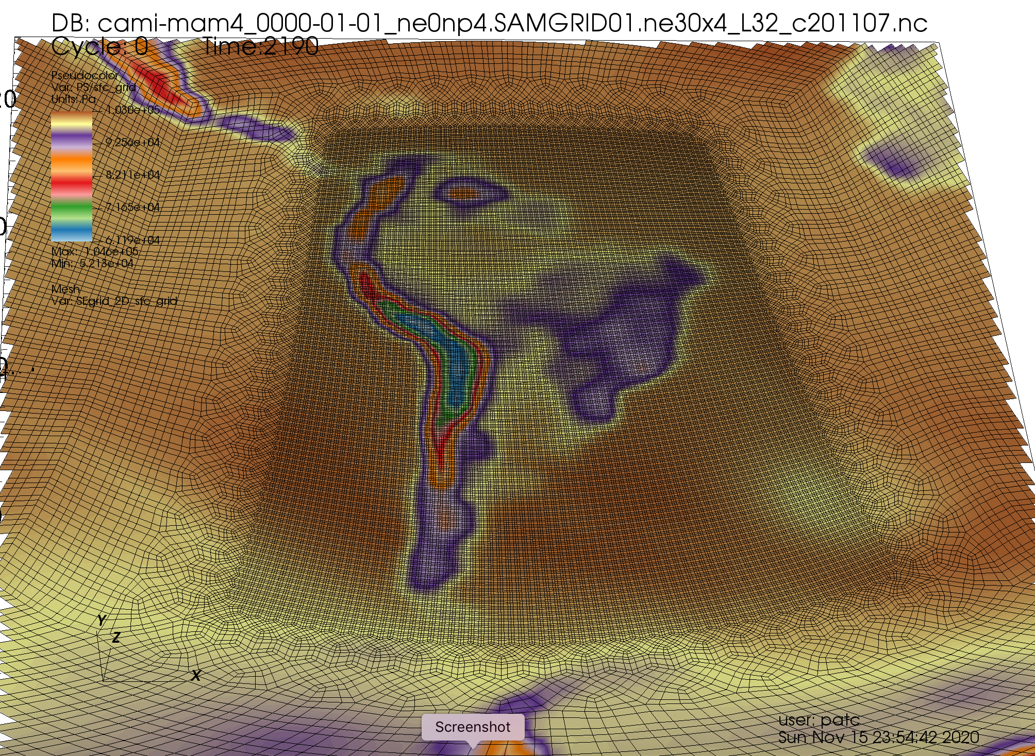
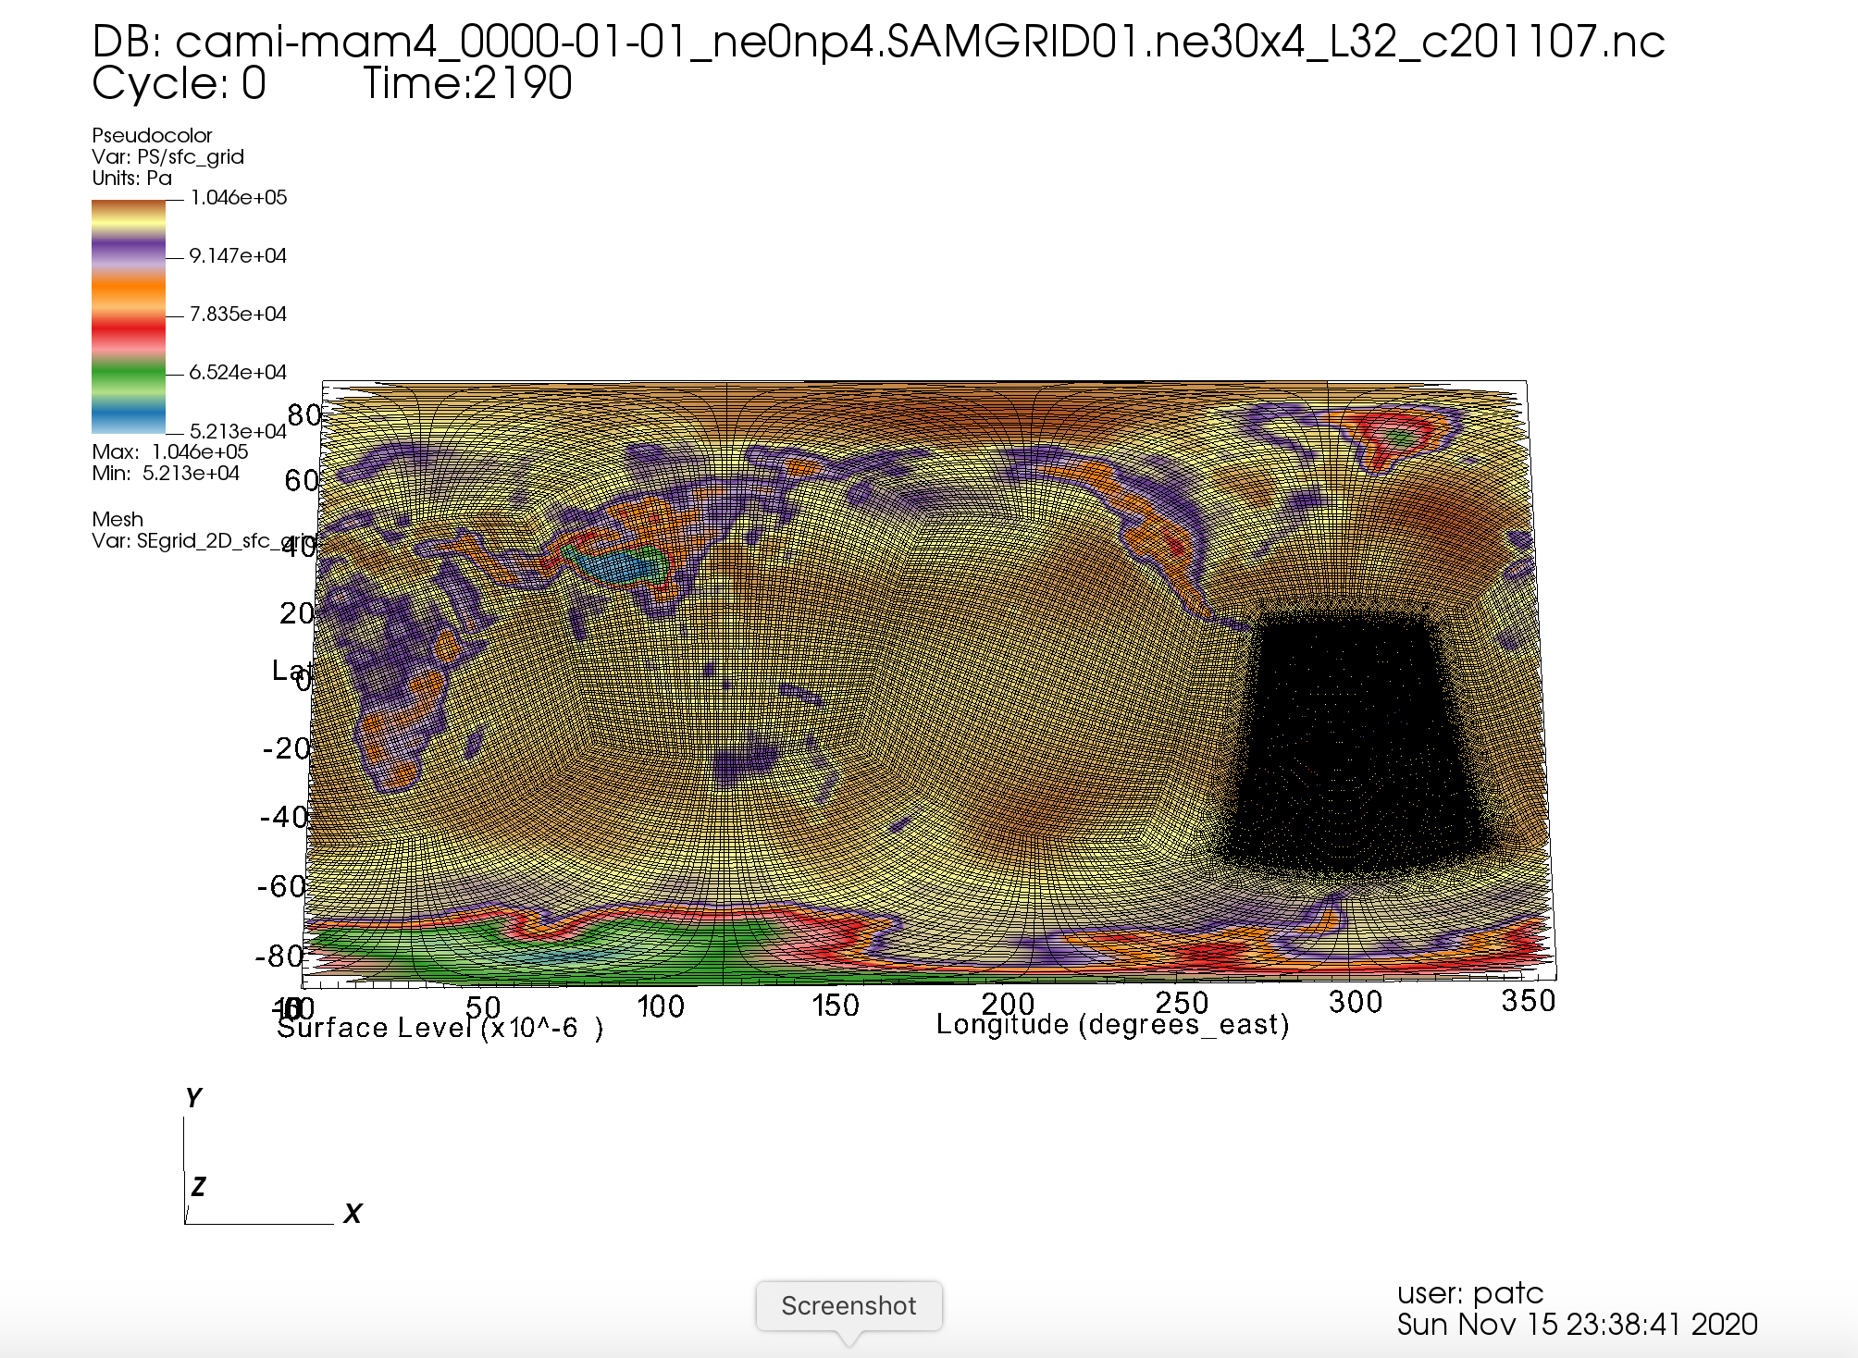
(7) Viewing Results
Example:

Slide 59
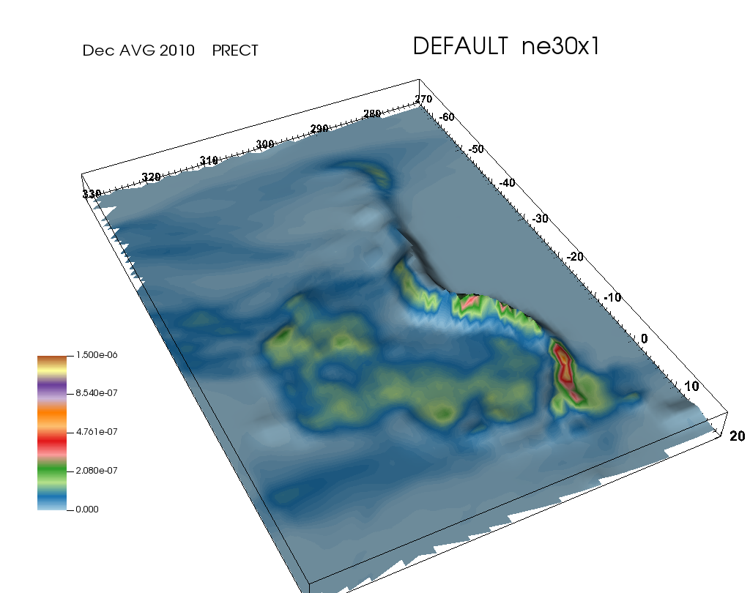


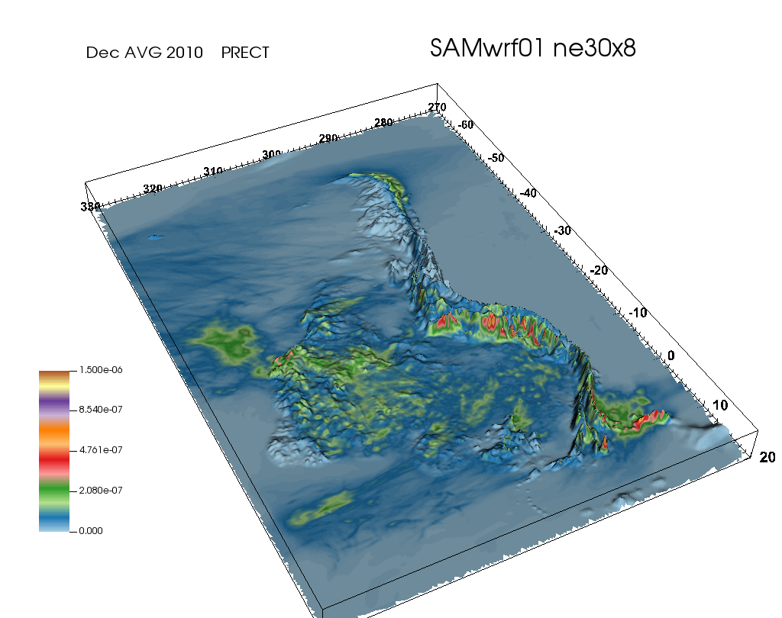
(7) Viewing Results
Example:
If PHIS is present in the history file, then 2D surface data can be plotted on a height surface.
Similarly, if PHI is contained in the history file, then 3D fields can also be plotted on height surfaces.

Slide 60
(8) Epilogue
Future Developments
Containerize processing for portability and avoid the module problem
Editor enhancements:
Add rotation option
Add Save/Restart
Add ability to edit refinement values like SQuadGen?
Feedback/Suggestions are welcome!
Preconfigured refinement domains rotated into position
Alternate editor – edit the cube grid directly
Variable Resolution Forum
User database where users can share grid configuration and established defaults
(e.g. EXODUS file, NLEV, NP, Namelist /shell_commands defaults)
Where to host it? Bulletin board/Wiki?
For now there is a “FAQ and Tips” page on the MUSICA wiki:
https://wiki.ucar.edu/display/MUSICA → “FAQ and Tips”
(Direct link) https://wiki.ucar.edu/pages/viewpage.action?pageId=441516283

